Slide 1
Quantum Enhanced Drug Ranking System for Comorbid Patients
Final Year Project :-
6th May, 2025
Guide - Dr. Mala T, Professor
Members - Diya Arshiya S (2021115033)
Preetham Vijayandhran (2021115077)
Samiukktha Dharmalingam (2021115089)
Sathyadharini Srinivasan (2021115097)

Slide 2
PROBLEM STATEMENT
Current cancer treatment systems often fail to provide personalized drug ranking that consider both the molecular profile of the cancer (such as the specific protein affected) and the patient's co-morbid conditions. This leads to suboptimal treatment choices, increased risk of adverse drug reactions, and compromised patient outcomes. Oncologists and clinical pharmacologists require a comprehensive system that identifies cancer-related drugs based on the patient's cancer-affected protein, evaluates potential drug interactions with medications for co-morbid conditions, and ranks cancer drugs based on efficacy, safety, and pharmacokinetic factors. Such a system can significantly enhance personalized cancer therapy, support informed decision-making, and improve patient care.

Slide 3
OBJECTIVE
The objective of this project is to develop a personalized cancer-disease drug ranking system that integrates molecular profiling and comorbidity considerations to optimize treatment selection. Specifically, the system aims to:
Identify and Prioritize Treatment Candidates: Retrieve FDA‑approved therapies for the patient’s co‑morbid condition and select a set of candidate cancer drugs (e.g. from the KIBA dataset) for further evaluation.
Quantify Molecular Interactions: Use automated docking (AutoDock Vina) to measure each cancer drug’s active torsional sites with the target cancer protein, and refine binding‑affinity predictions via a hybrid quantum‑classical CNN.
Assess Safety and Pharmacokinetics: Predict key ADMET properties (absorption, distribution, metabolism, excretion, toxicity) for each drug using an XGBoost model, ensuring both efficacy and patient safety.
Integrate Metrics into Personalized Rankings: Evaluate drug–drug interaction risk via molecular similarity, then combine docking scores, binding affinities, ADMET profiles, and DDI risk into a unified TOPSIS score to rank the best cancer–co‑morbid drug pairs for truly personalized therapy.

Slide 4
LITERATURE SURVEY:
Title of the Article | Authors and Year of Publication | Highlights of Approaches Followed | Challenges to be Addressed
A New Quantum Circuits of Quantum Convolutional Neural Network for X-Ray Images Classification | Authors: M. Yousif, B. Al-Khateeb and B. Garcia-Zapirain. Publisher: IEEE Access, vol. 12, pp 2024 | Utilizes quantum circuits to enhance feature extraction, improving accuracy and processing speed. Evaluates QCNN performance on MNIST and covidx-cxr3 datasets, showing superior results in recognition accuracy and efficiency. | Quantum computing resources are limited, making it challenging to scale QCNNs for large datasets. Quantum systems are prone to errors and decoherence, affecting model reliability and consistency.
Hybrid Quantum Neural Network Approaches to Protein–Ligand Binding Affinity Prediction | Authors: Avramouli, M.; Savvas, I.K.; Vasilaki, A.; Tsipourlianos, A.; Garani, G. Publisher: MDPI , 2024 | Hybrid quantum-classical models accelerate training, require fewer epochs, and generalize better than classical deep learning models. | Binding affinity values need careful scaling to fit within the range of quantum circuit outputs, impacting prediction accuracy.

Slide 5
Title of the Article | Authors and Year of Publication | Highlights of Approaches Followed | Challenges to be Addressed
Development of the Emirates Multi-Criteria Decision Analysis Tool for Orphan Drugs. | Authors: Alnaqbi, K. A., Elezbawy, B., Fasseeh, A. N., Bangash, A. R., Elshamy, A., Shendi, H., Aftab, M. I., AlMarshoodi, M., Gebran, N., AlDhaheri, N., Fahmy, S. A., Al Dallal, S., Al Naeem, W., Abaza, S., & Kaló, Z. Publisher: PubMed Journal, 2024 | Developed an MCDA tool tailored for evaluating orphan drugs in the UAE. Incorporated ten weighted criteria like cost-effectiveness and disease severity. | Balancing conflicting criteria during evaluations. Limited availability and variability of orphan drug data.
Integration of FAERS, DrugBank and SIDER Data for Machine Learning-based Detection of Adverse Drug Reactions | Authors: Schreier, T., Tropmann-Frick, M. & Böhm, R.(2024). Publisher: Springer, Journal Datenbank Spektrum, 2024 | FAERS, DrugBank, and SIDER enhance machine learning-based detection of adverse drug reactions (ADRs). Demonstrated that adding drug and event-related features significantly improves ML model performance. | Reliance on existing ADR data from SIDER, which may include outdated or incorrect entries, affecting label accuracy. Hardware limitations restricted the dataset size and dimensionality, potentially excluding valuable features

Slide 6
Title of the Article | Authors and Year of Publication | Highlights of Approaches Followed | Challenges to be Addressed
ADMETboost: a web server for accurate ADMET prediction | Authors: Tian, H., Ketkar, R. & Tao, P. Publisher: Springer, Journal of Molecular Modeling, 2022 | The model utilizes multiple molecular fingerprints and descriptors (MACCS, Mol2Vec, PubChem, Mordred, RDKit) to capture structural and chemical properties effectively. Randomized grid search and 5-fold cross-validation were applied to fine-tune parameters, ensuring optimal model performance. | Previous ADMET prediction models were trained on different datasets, making it difficult to compare their performance fairly. With over 100,000 possible hyperparameter combinations, finding the best configuration is computationally expensive.
A method for systematically ranking therapeutic drug candidates using multiple uncertain screening criteria | Authors: Peng X, Gibbs E, Silverman JM, Cashman NR, Plotkin SS. Publisher:PubMed Journal, 2021 | A systematic framework was used to assess and rank options based on diverse factors such as efficacy, safety, and interaction potential using TOPSIS. Combined data sources with machine learning and quantum-enhanced techniques to improve predictive performance and decision-making . | Integrating data from various sources with differing formats, scales, and reliability requires robust preprocessing and normalization to ensure fair comparison and input compatibility for the ranking algorithm.

Slide 7
Title of the Article | Authors and Year of Publication | Highlights of Approaches Followed | Challenges to be Addressed
Feature selection strategies for drug sensitivity prediction | Authors: Koras, K., Juraeva, D., Kreis, J., Mazur, J., Staub, E., Szczurek, E Publisher: Scientific Reports, 10(1), 9377. | Domain‑based features excelled for 23 drugs, while transcriptomic signatures boosted accuracy for 60 (e.g., Dabrafenib). Linifanib led with r = 0.75 among 2,484 models, and even minimal drug‐feature subsets were highly predictive. | Drug data often contains thousands of molecular or genomic features; selecting the most relevant ones is critical to avoid overfitting and improve accuracy. Drug sensitivity and ADMET properties depend on complex, partially unknown biological mechanisms, making prediction inherently difficult.
An Informatics-based Approach to Identify Key Pharmacological Components in Drug-Drug Interactions | Authors: Deng, J., Wang, F. (2020) Publisher: Pubmed,AMIA Jt Summits Transl Sci Proc, 2020 May | Utilizes a comprehensive and high-quality DDI dataset, enhancing reliability and coverage. A transparent and interpretable model is used to classify interactions and assess feature importance. | Linear Model Constraint: Logistic regression may fail to capture complex, nonlinear relationships present in DDIs.

Slide 8
LITERATURE SURVEY SUMMARY
Quantum & Hybrid Models
QCNNs enhance image classification but face scaling issues (IEEE, 2024).
Hybrid models improve training speed and generalization in binding prediction (MDPI, 2024).
Drug Evaluation
ADMETboost achieves high accuracy using diverse descriptors (Springer, 2022).
Feature selection is critical in drug sensitivity models (Sci. Reports, 2020).
Decision Tools
MCDA supports orphan drug assessment with 10 criteria (PubMed, 2024).
TOPSIS + ML/quantum aids drug ranking (PubMed, 2021).
ADR & DDI Analysis
ADR detection improved by database integration (Springer, 2024).
DDI models are interpretable but may miss complex patterns (AMIA, 2020).
’

Slide 9
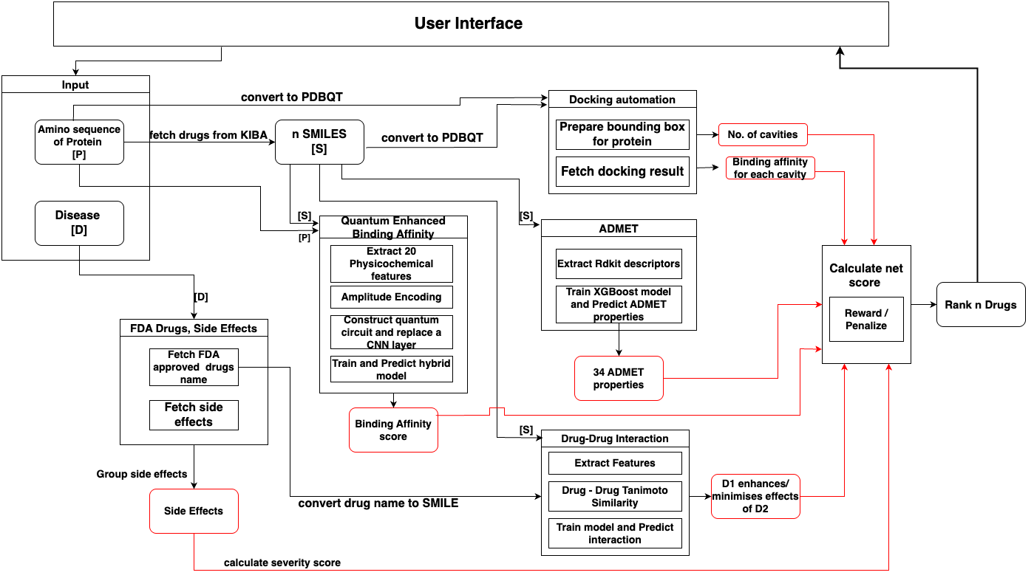
ARCHITECTURE DIAGRAM

Slide 10
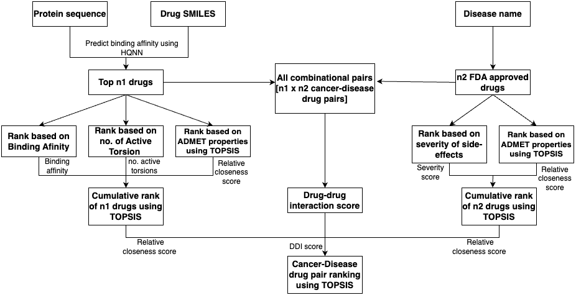
RANKING FLOW DIAGRAM

Slide 11
DRUG -RANKING MECHANISM
Ranking list of drug pair candidates optimized for efficacy and safety of Co-morbid patients
Input:
Target protein sequence, Number of cancer‐drug candidates (n), Comorbid disease name.
Criteria Considered:
Binding Affinity scores, Side effects severity, ADMET properties, Active torsional sites, Drug-Drug Interaction scores.
Output:
Ranking of drug pairs based on 5 criterias.
Methodology
Cancer‑Drug Ranking Track
Affinity Prediction: The hybrid QCNN evaluates all KIBA compounds and selects the top n strongest binders for further analysis.
Molecular Docking: AutoDock Vina docks each of the top n ligands and counts the number of active torsional sites, ranking compounds so that fewer torsions indicate better structural compatibility.
ADMET Profiling: An XGBoost model predicts the pharmacokinetic and safety profiles for each of the n compounds, and TOPSIS reduces the outputs into a single ADMET-based ranking.
Composite TOPSIS: The affinity, torsion, and ADMET rankings are merged using TOPSIS to produce a final potency safety composite rank for the cancer-drug candidates.

Slide 12
Comorbid‑Disease Drug Ranking Track
Side‑Effect Severity: FDA-approved drugs for the specified comorbid disease are scored by averaging the product of severity and frequency across all reported side effects, and then ranked from lowest to highest severity index.
ADMET Profiling: The same XGBoost and TOPSIS pipeline is applied to these drugs to predict and rank their pharmacokinetic and toxicity profiles.
Composite TOPSIS: The severity index and ADMET rankings are integrated using TOPSIS to yield a unified, safety-focused ordering of comorbid-disease drugs.
Drug–Drug Interaction Integration
Pair Generation: All possible combinations between the top cancer-drug candidates and comorbid-disease drugs are generated.
Interaction Prediction: A Random Forest classifier predicts the likelihood of drug–drug interactions for each pair based on molecular features.
Final TOPSIS: The DDI risk score, cancer-drug score, and disease-drug score are normalized and merged via TOPSIS to identify the most suitable treatment pair for the patient.

Slide 13
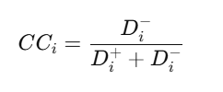
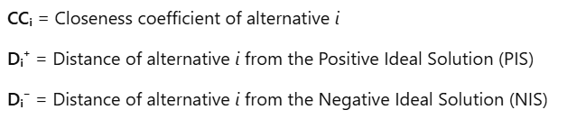
TOPSIS(Technique For Order Preference By Similarity To Ideal Solution) RANKING WORKFLOW
Purpose: Ranks alternatives based on their closeness to the ideal solution.
Steps:
Construct Decision Matrix: Alternatives × Criteria.
Normalize Matrix: Apply Euclidean normalization to each column.
Weight Criteria: Multiply normalized values by criterion weights.
Identify Ideal Solutions:
PIS: Best value for each criterion.
NIS: Worst value for each criterion.
5. Calculate Distances: Distance of each alternative from PIS and NIS.
Outcome: Transparent, balanced, and weighted ranking of all options.
6. Compute Closeness Coefficient (CC)

Slide 14
TOPSIS CALCULATION
Divide by Norm
Drug | Prop 1 | Prop 2
a | 4 | 11
b | 7 | 12
c | 5 | 5
Drug | Prop 1 | Prop 2
a | 0.42 | 0.65
b | 0.74 | 0.70
c | 0.53 | 0.29
Norm Prop 1 = 9.40
Norm Prop 2 = 17.03
Multiply by weight
Calculate relative closeness
Drug | Prop 1 | Prop 2
a | 0.21 | 0.325
b | 0.37 | 0.35
c | 0.26 | 0.145
Drug | Prop 1 | Prop 2 | S+ | S- | x= S+ + S- | C=S-/x
a | 0.21 | 0.325 | 0.03 | 0.24 | 0.27 | 0.88
b | 0.37 | 0.35 | 0.16 | 0.21 | 0.37 | 0.56
c | 0.26 | 0.145 | 0.21 | 0.11 | 0.32 | 0.34
Rank 1
Rank 2
Rank 3
x weight :
0.5 | 0.5
S1+ = root( (0.21-0.21)^2 + (0.325-0.35)^2) = 0.03
S1- = root( (0.21-0.37)^2 + (0.325-0.145)^2) = 0.24

Slide 15
DATASETS
SIDER:
Umls_id -Unique identifier for the drug in the Unified Medical Language System (UMLS).
Pref_low- Whether the side effect is a Preferred Term (PT) or Lower-Level Term (LLT) in MedDRA.
Medra-The MedDRA (Medical Dictionary for Regulatory Activities) code for the side effect.
Se- Side effect description (e.g., "Pain", "Rash", "Anaemia").
Gname - The generic drug name associated with the side effect.
KIBA:
CHEMBLID - drug id
ProteinID - protein id
compound_SMILES - a text-based representation of a chemical molecule
Target_seq - amino acid sequence of protein
Ki, Kd and IC50 (KIBA Score) - Binding affinity
Total number of drugs :1,430 drugs
Total number of side effects : 5868
SIDER dataset is maintained and curated by the European Bioinformatics Institute (EBI), which is part of the European Molecular Biology Laboratory (EMBL).
Total number of drugs : 2,111
Total number of proteins : 229
Total number of drug-target pairs : 118,254

Slide 16
Drug Bank DDI:
X1-Drug 1 considered for DDI
X2- Drug 2 considered for DDI
Map- Interaction description
Y-interaction score
0-Highly recommended
1-Permissible
2-Least advisable
Severity Dataset:
Name- Side effect name.
Rank Score- Side effect severity score.
frequency- side effects frequency percentage(occurrence)
Total number of Side effects : 2,930
MedDRA is an international medical database with an emphasis on use for data entry, retrieval, analysis, and display
Total number of drug pairs :191809
DrugBank is a vital resource for your pharmaceutical research, offering comprehensive & reliable drug data

Slide 17
MODULES
FDA approved Drugs and Side-effects extraction
ADMET_XGBoost model to extract ADMET properties
Automation of Docking results
Quantum enhanced binding affinity prediction
Drug-Drug Interaction

Slide 18
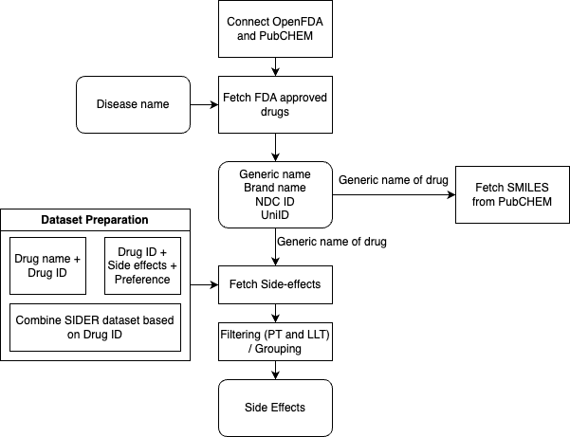
DETAILED DESIGN OF FDA-APPROVED DRUGS, SMILES & SIDE EFFECTS SEVERITY

Slide 19
Fetching FDA-Approved Drugs, SMILES Representation & Side Effects Mapping
Data
Sources: PubChem, openFDA
Dataset:- SIDER(Side effects resource), Severity dataset(MedDRA)
Methodology
Fetch FDA-approved drugs for any input disease.
- It extracts and validates key identifiers such as brand names, generic names, UNII identifiers for further ranking.
Retrieve molecular structures (SMILES) from PubChem.
- Using the drugs generic name SMILES structure of all the FDA approved drugs are fetched.
- SMILES structures used/given as input for Drug-Drug interaction.
Map and categorize side effects using SIDER
- Extracted generic names of the drugs are mapped to the SIDER dataset to filter and ……………..extract the most clinically relevant side effects of the drugs filtering only the Preferred Terms (PT).
Side Effect mapping to severity scores and severity index calculation.
- Side effects are mapped to severity and frequency scores from the MedDRA Severity dataset, then ...averaged ..as a weighted sum to compute a normalized severity index for each drug , preparing it for …ranking.
Input: Disease
Output:
Approved list of drugs
Generic name
Smiles representation
Side effects and severity index
All drugs and side effects fetched are approved , verified by Food and Drug administration(FDA) and European Molecular Biology laboratory(EMBL).

Slide 20
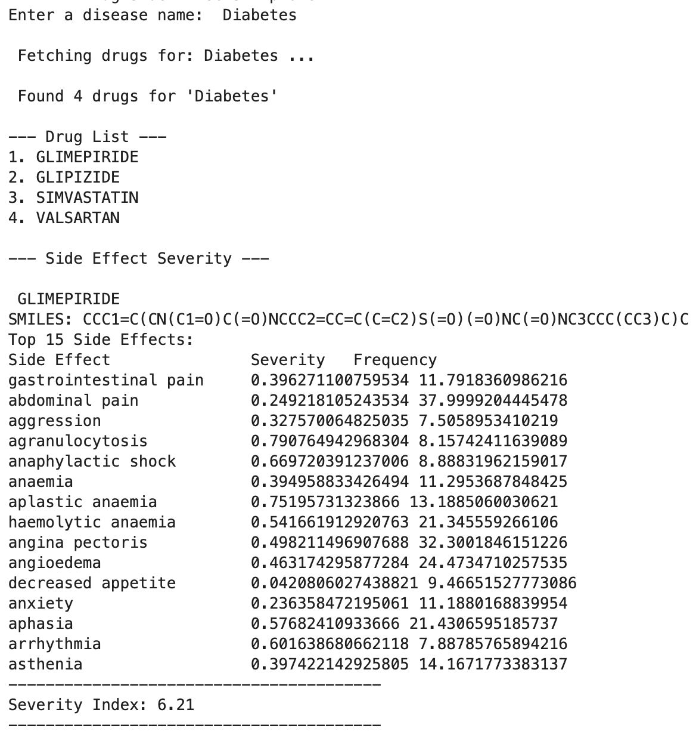
Sample input/output for fetching FDA drugs and side effects

Slide 21
Algorithm Side-effect_Extraction
input : Disease name
output: Approved list of drugs with SMILE representation and Side effects
given: sider_df (Gname,Se,Pref_low)
{
Func. get_smiles_from_generic_name(generic_name): #Extracting SMILES
Set url for PubChem
Make a GET request to the PubChem API with (formatted generic_name)
If the request successful:
Parse the returned JSON to extract the SMILES string
Return smiles
Func. map_similar_side_effects(side_effects_list): #Grouping Side Effects
Create a dictionary side_effect_mapping to define mapping rules
For each side effect in the list:
Check if it matches any terms in the dictionary
If a match is found:
Map it to the corresponding category
Else:
keep the side effect as is
Set base_url and parameters for search of drugs
Make a GET request to the openFDA API with (Disease name)
If request successful data is returned:
Extract drug information, such as brand name, generic name, product NDC, and UNII
Skip duplicates based on the generic name
Call get_smiles_from_generic_name(genric_name) to fetch SMILES.
Load sider_df and retrieve side effects (Se_list) based on generic name and group them using map_similar_side_effects(Se_list)
Return dictionary of unique drugs with information, side effects and smiles.
}
side_effect_mapping =[ "abdominal pain": ["abdominal discomfort", "abdominal distension", "abdominal pain", "abdominal pain upper", "abdominal pain lower"], "rash": ["skin rash", "maculopapular rash", "erythematous rash", "rash maculopapular”] ,"headache": ["headache", "severe headache", "migraine"]

Slide 22
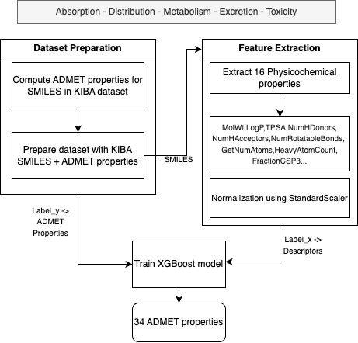
2. DETAILED DESIGN OF ADMET_XGBoost

Slide 23
ADMET Properties
Absorption
HIA_Hou (Human intestine absorption)
PAMPA_NCATS (permeability)
Pgp_Broccatelli (interaction with P glycoprotein)
Caco2_Wang (permeability)
Distribution
BBB_Martins (blood brain barrier crossing)
Bioavailability_Ma
PPBR_AZ (plasma protein bond ratio)
Lipophilicity_AstraZeneca (solubility in fats, oil, tissue)
Metabolism
CYP450 enzyme interactions such as CYP1A2_Veith, CYP2C19_Veith, and CYP3A4_Veith. (interaction with cytochrome which influences metabolism)
Substrate_CarbonMangels (if it’s a substrate for cytochrome enzyme)
Excretion
Clearance_Hepatocyte_AZ (rate of clearing from liver)
Clearance_Microsome_AZ (clearing from microsomes)
Half_Life_Obach (time to reach half concentration)
VDss_Lombardo (distribution of drug in body)
Toxicity
AMES (predicts likeliness of mutation)
Carcinogens_Lagunin (predicts likeliness of cancer)
ClinTox (measure of toxicity)
DILI (drug induced liver damage)
hERG inhibition (measure potential block of hERG potassium channel)
Skin_Reaction. (predicts likeliness of skin reactions like rashes.)
Other molecular properties
Molecular weight
logP (solubility in fats, oil and tissue)
Hydrogen bond acceptors/donors
Lipinski's rule compliance (likely orally active drug)
QED (quantifies how drug-like a molecule is)
Stereo centers (number of stereocenters)
TPSA (polarity of compound)

Slide 24
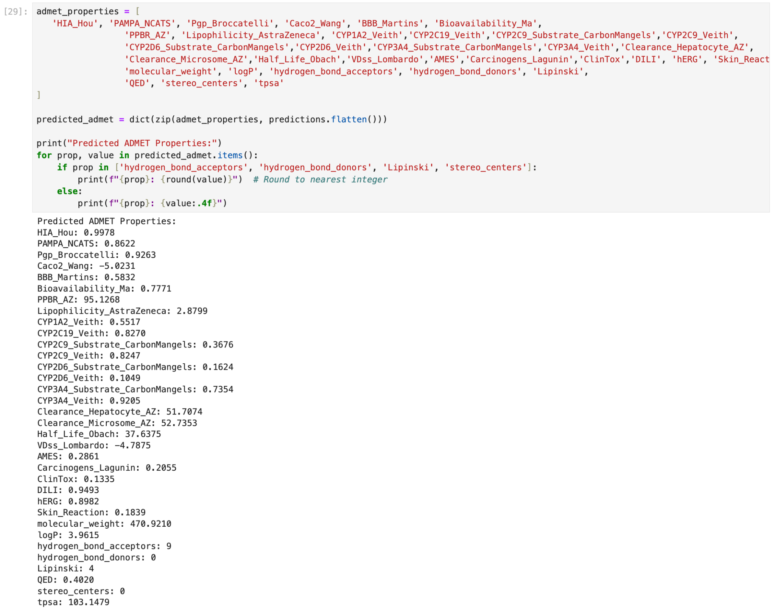
Sample input/output for ADMET_XGBoost
Input:
Output:

Slide 25
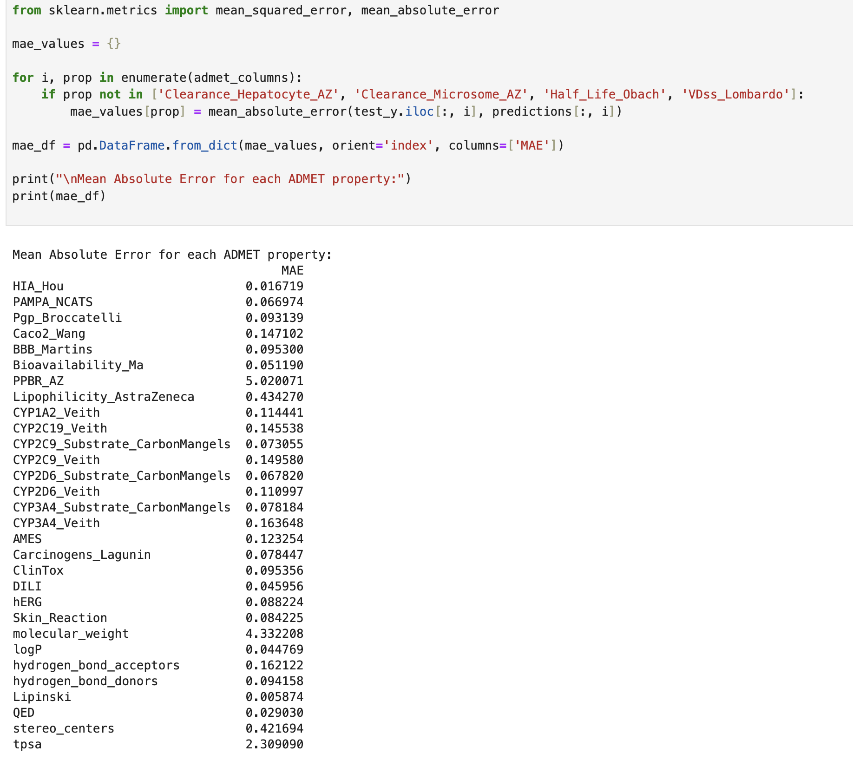
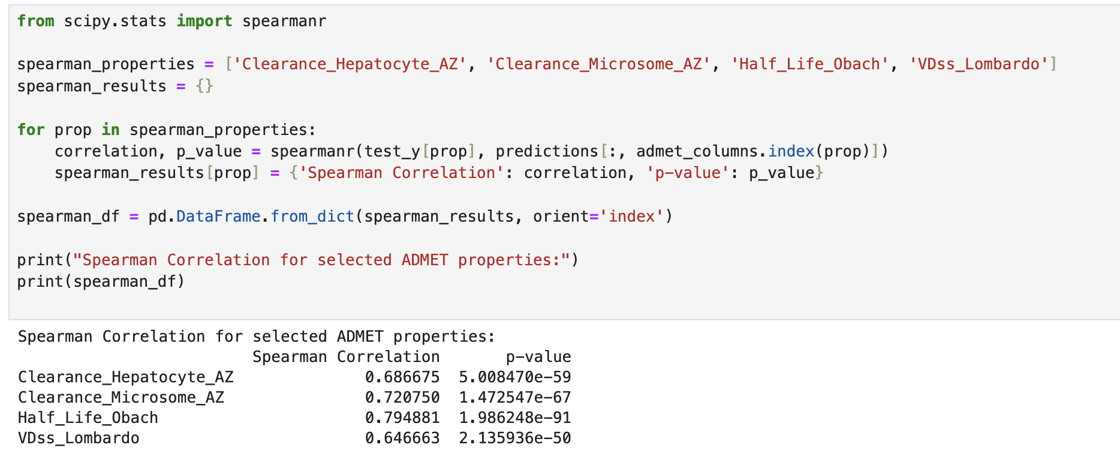
Evaluation of ADMET_XGBoost

Slide 26
Algorithm ADMET_XGBoost
input : SMILES representation of drug
output: 34 ADMET properties
given: kiba_smile_admet dataset (SMILES, 34 ADMET properties)
{ Func. extract_descriptors(smiles): #Extracting Physicochemical features
Convert the SMILES string to a molecular object using RDKit's Chem.MolFromSmiles()
If the molecule is valid:
Calculate various descriptors using Descriptors.MolWt(mol)
descriptor = [MolWt, MolLogP, TPSA, NumHDonors, NumHAcceptors, NumRotatableBonds, GetNumAtoms,
HeavyAtomCount, NumAromaticRings, NumHeteroAtoms, MolMR, Kappa1, Kappa2, Kappa3,
FractionCSP3, RingCount ]
return descriptor
Else:
return None
Load kiba_smile_admet dataset
Split dataset into train and test (80:20 ratio)
Extract features for train and test using extract_descriptors(smiles) and store it in train_features and test_features
Scale the features using StandardScaler to normalize the data and store in train_features_scaled and test_features_scaled
To train_y and test_y assign the ADMET properties from train and test, excluding the SMILE, to set as target for prediction
Initialize the model xgb_model = XGBRegressor()
Perform hyperparameter tuning using HalvingGridSearchCV with cross-validation and find the best_model based on the R² score
Train the model using train_features_scaled and train_y
Make predictions on test_features and test_y to evaluate
Make Predictions for new Drug SMILES to predict ADMET properties
}

Slide 27
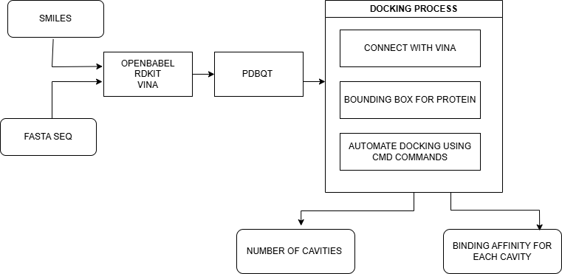
3. DETAILED DESIGN OF DOCKING RESULTS (Active Torsion Sites)
Number of active torsions

Slide 28
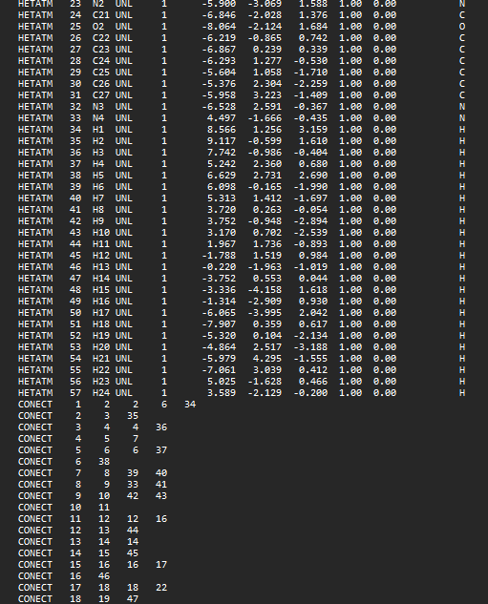
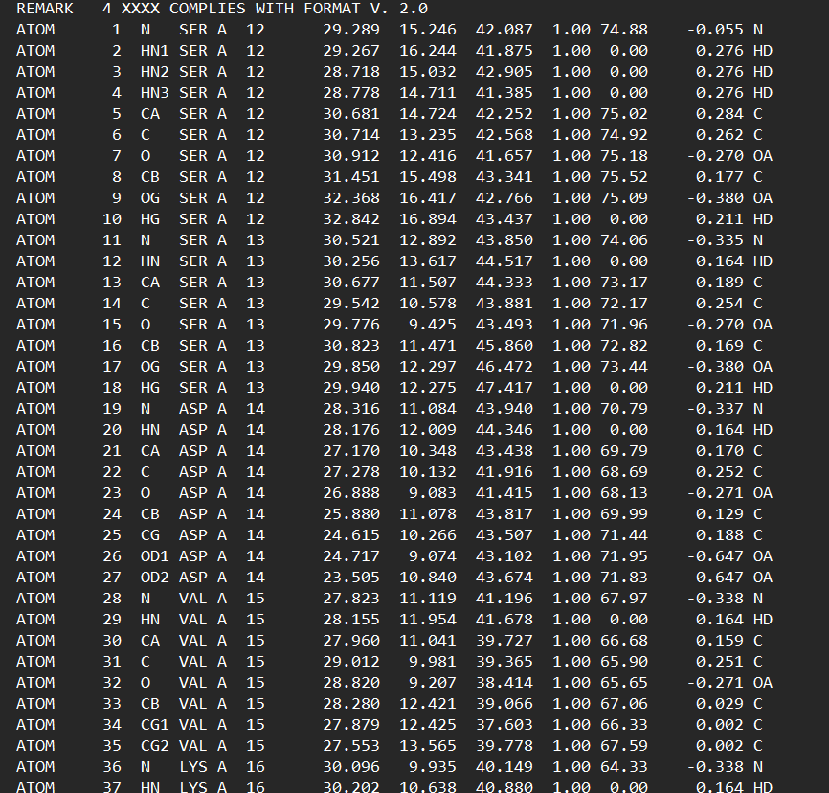
Docking Actual Steps
COC(=O)CCC1=C2N(\C=C3/N..
rdkit()
smile_1
MQSKVLLAVALWLCVETRAAS..
pro_seq_1
openbabel()
Pdb file smile_1
Pdbqt file pro_seq_1

Slide 29
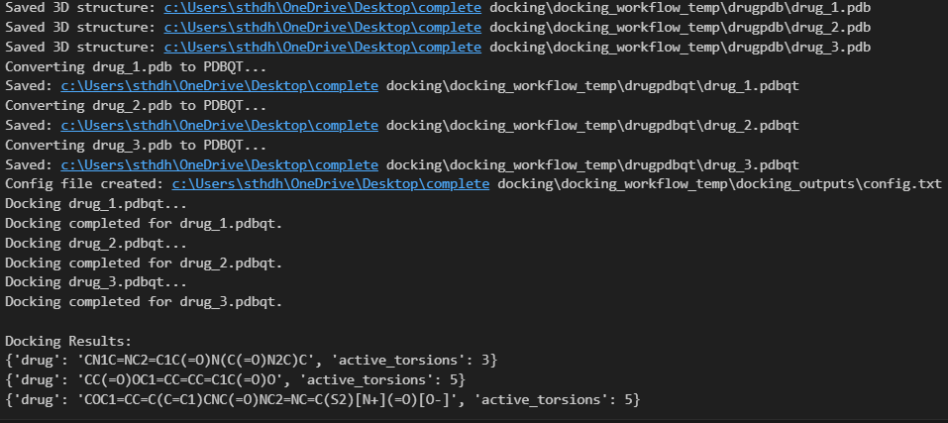
Actual output of Docking to get Active Torsions

Slide 30
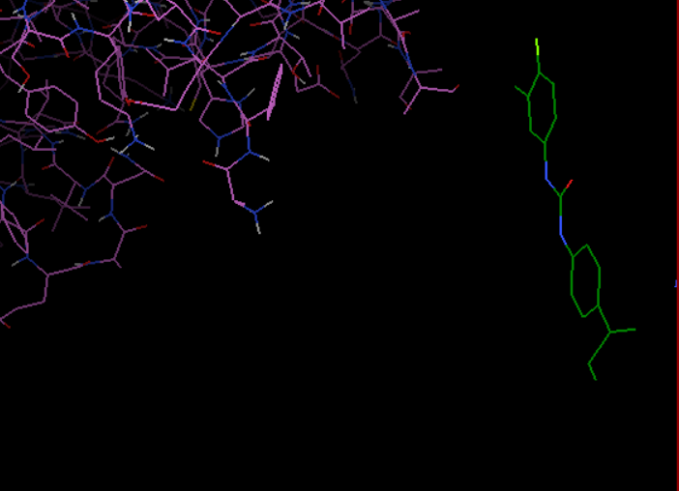
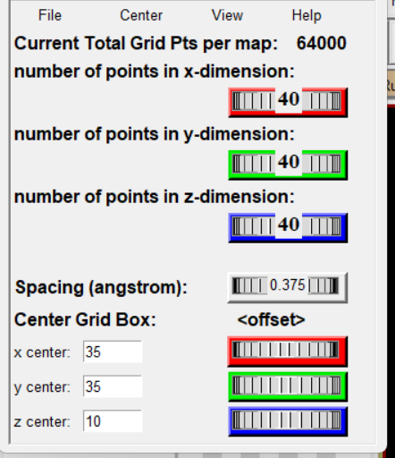
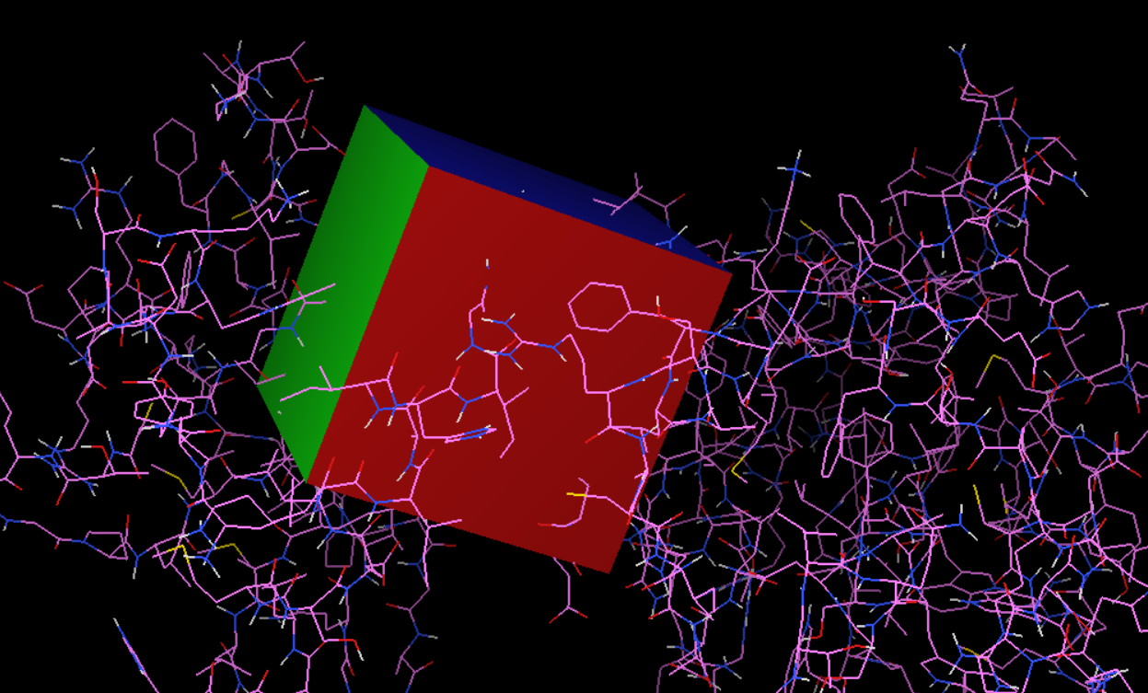
Manual docking using Vina
(1) .pdb file of drug and protein.
(2) Conversion of .pdb to .pdbqt for docking
(3) Grid Box construction to focus relevant regions of protein.
(4) Docking

Slide 31
Automation of Docking of Drug on Target’s Active Sites using Vina
It is responsible for simulating the interaction between drug molecules and target proteins, predicting their binding affinities , most stable binding poses and number of active torsions
Methodology:
PREPARING INPUT:
Convert the PDB file for drug and protein to PDBQT format which is necessary for docking.
1. Using AutoDockTools in MGLTools, the protein is preprocessed by
Removing water molecules
Adding polar hydrogens
Adding Kollman charges
2. Similarly, the drug molecule, obtained in PDB format, is converted into a PDBQT file using PyMOL, where
Structure is optimized for docking
3. The active site of the protein, where the drug is likely to bind, must be identified. A grid box is created around the active site using AutoDockTools, with specific coordinates (x, y, z). This grid box defines the search space for docking.
DOCKING:
Docking is done in AutoDock Vina, where the PDBQT files of the protein and drug, along with the grid box configuration, are input into the software. It evaluates multiple binding poses (9) of the drug within the protein’s active site, calculating a binding affinity score for
each pose.

Slide 32
Input: Smile sequence
Output: Docking results (Number of Active Torsions)
Step 1: Protein Preparation
Download Protein PDB File
Retrieve PDB structure from RCSB PDB based on Protein ID.
If not found, check AlphaFold or other sources.
Save it as {protein_id}.pdb in the protein database folder.
Prepare Protein for Docking
Remove water molecules.
Add missing hydrogens.
Convert PDB → PDBQT using AutoDockTools.
Save as {protein_id}.pdbqt in the docking folder.
Step 2: Ligand Preparation
Convert SMILES to 3D Ligand Structure
Use RDKit to convert SMILES → PDB.
Optimize 3D conformation using ETKDG algorithm.
Save as ligand.pdb.
Prepare Ligand for Docking
Add hydrogens.
Convert PDB → PDBQT using AutoDockTools.
Save as ligand.pdbqt in the docking folder.
Algorithm for Automated Docking Workflow

Slide 33
Step 3: Define Docking Grid
Compute Binding Site Box
Extract protein's active site coordinates.
If binding site is unknown, compute bounding box based on the whole protein.
Define docking grid center (x, y, z) and size (size_x, size_y, size_z).
Step 4: Docking Execution
Run AutoDock Vina
Execute Vina with:
Receptor PDBQT
Ligand PDBQT
Grid center & size
Exhaustiveness level
Generate docked conformations in out.pdbqt.
Step 5: Analyze Docking Results
Extract Docking Scores
Parse out.pdbqt to extract:
Number of Active torsions

Slide 34
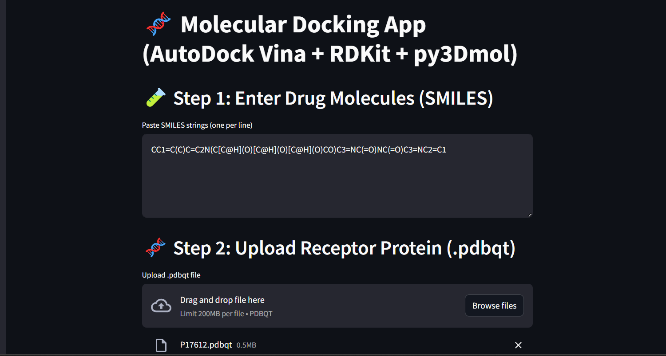
Sample test case example to fetch Number of ACTIVE TORSIONS

Slide 35
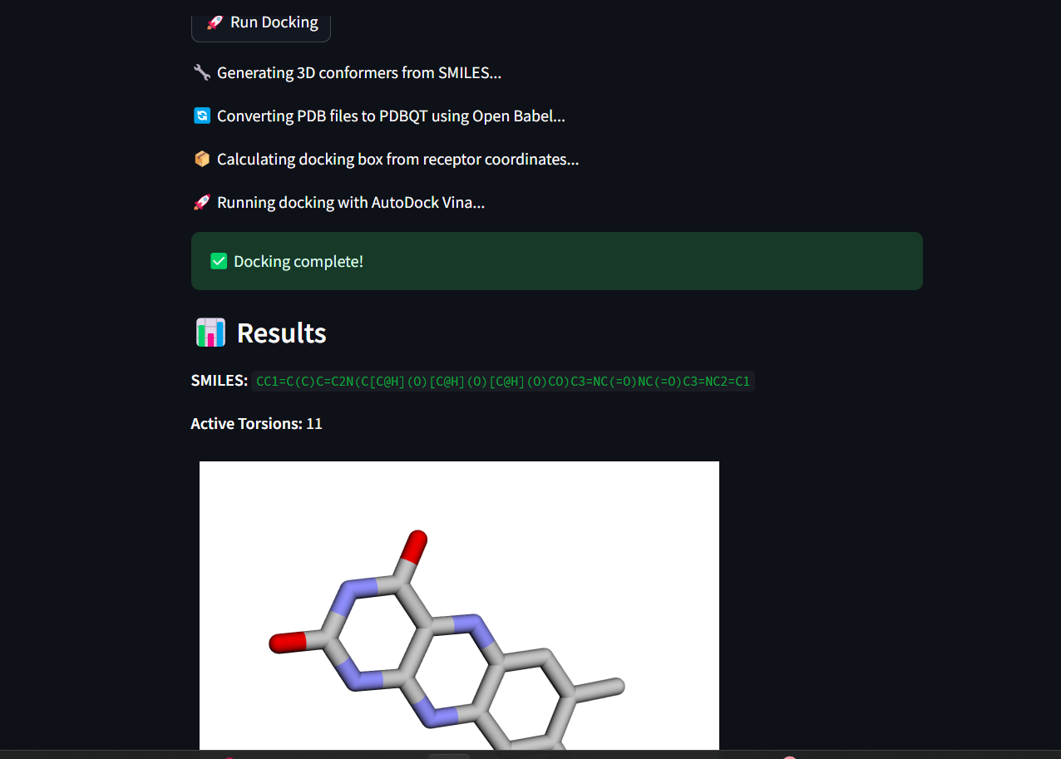
Sample test case example to fetch Number of ACTIVE TORSIONS

Slide 36
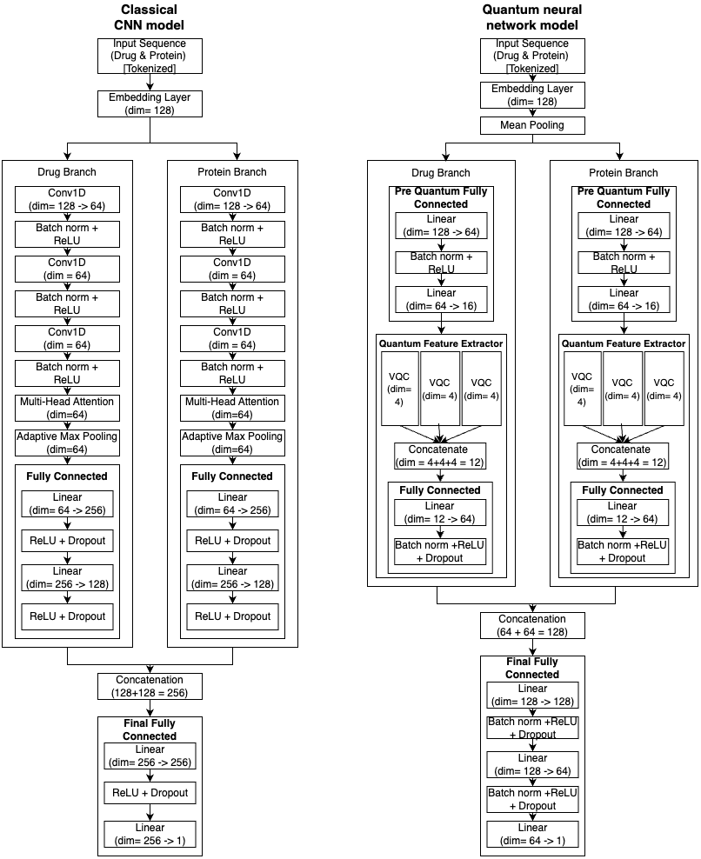
4. DETAILED DESIGN OF QUANTUM ENHANCED BINDING AFFINITY PREDICTION

Slide 37
Quantum-Enhanced Binding Affinity Prediction
Predicted binding affinity scores with enhanced precision by decreasing run time.
Methodology
Character tokenization of input
Embedding to 128 dimensional vector
Convolutional neural network (CNN) construction with 3 Conv1D layers and fully connected layers
Quantum circuit construction with quantum gates-
Amplitude Encoding: Covert classical data to quantum states
Hadamard gate: superposition, maps to large feature space and explore multiple paths simultaneously (eliminates need for MultiAttentionHead)
RX, RY, RZ variational gates: Rotates qbits by varying angle analogs to adjusting weights in Neural networks
S gate: introduce non-linearity like ReLU by applying phase shift only to |1> but not to |0>
CNOT and CZ gate: entangles qbits to capture more complex correlation
Replacing Conv1D layer in CNN with quantum circuit built in step 4
Major Tools / Frameworks
Pennylane
Torch
Input: Drug SMILE, Protein sequence
Output:
Predicted binding affinity scores with enhanced precision with low run time.

Slide 38
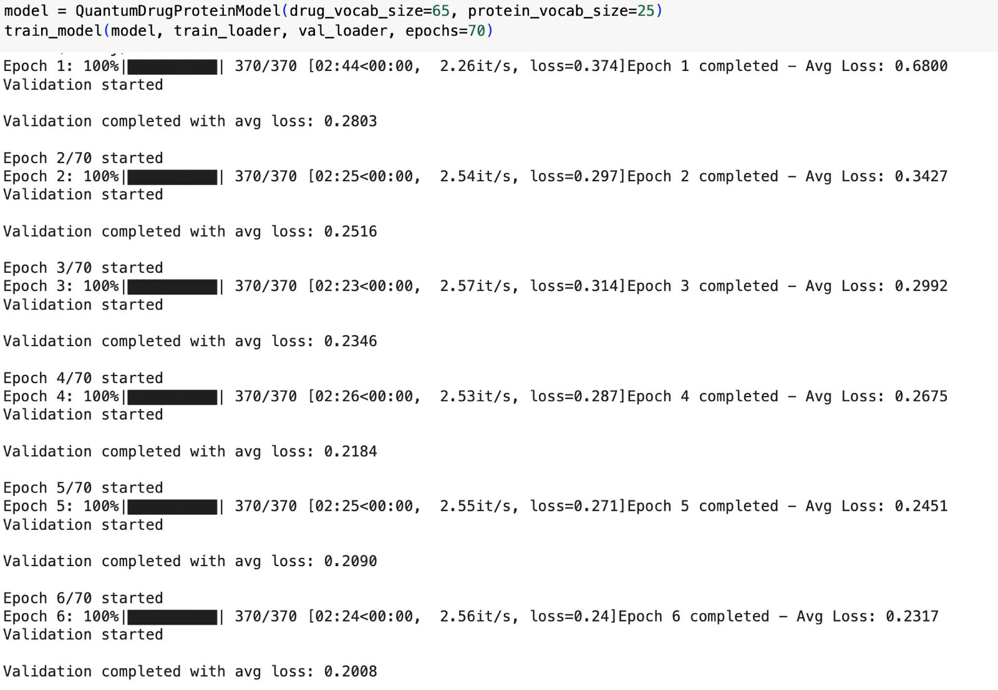
Evaluation of Quantum Neural Network
Mean Squared Error (MSE): 0.3208
Root Mean Squared Error (RMSE): 0.5664
Pearson Correlation: 0.7341
R2 Score (Regression Accuracy): 0.5380
Accuracy: 81.25%
Average inference time over 100 runs: 37.187 ms
Convergence speed-: 0.00030 loss-points per epoch
2:25 minutes on average per epoch
2 hours 53 minutes complete training time

Slide 39
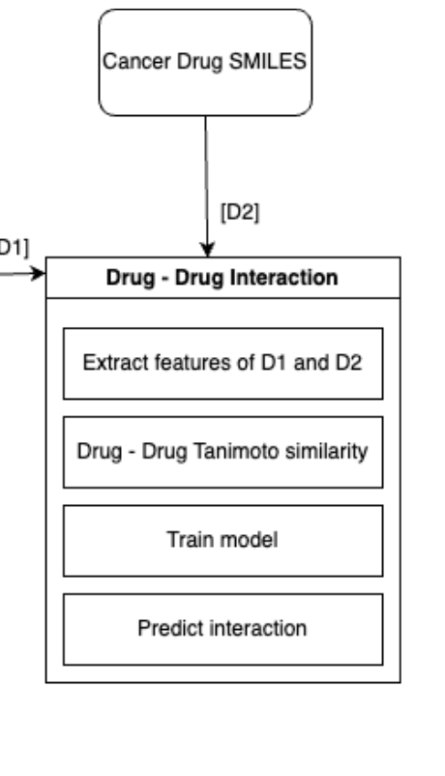
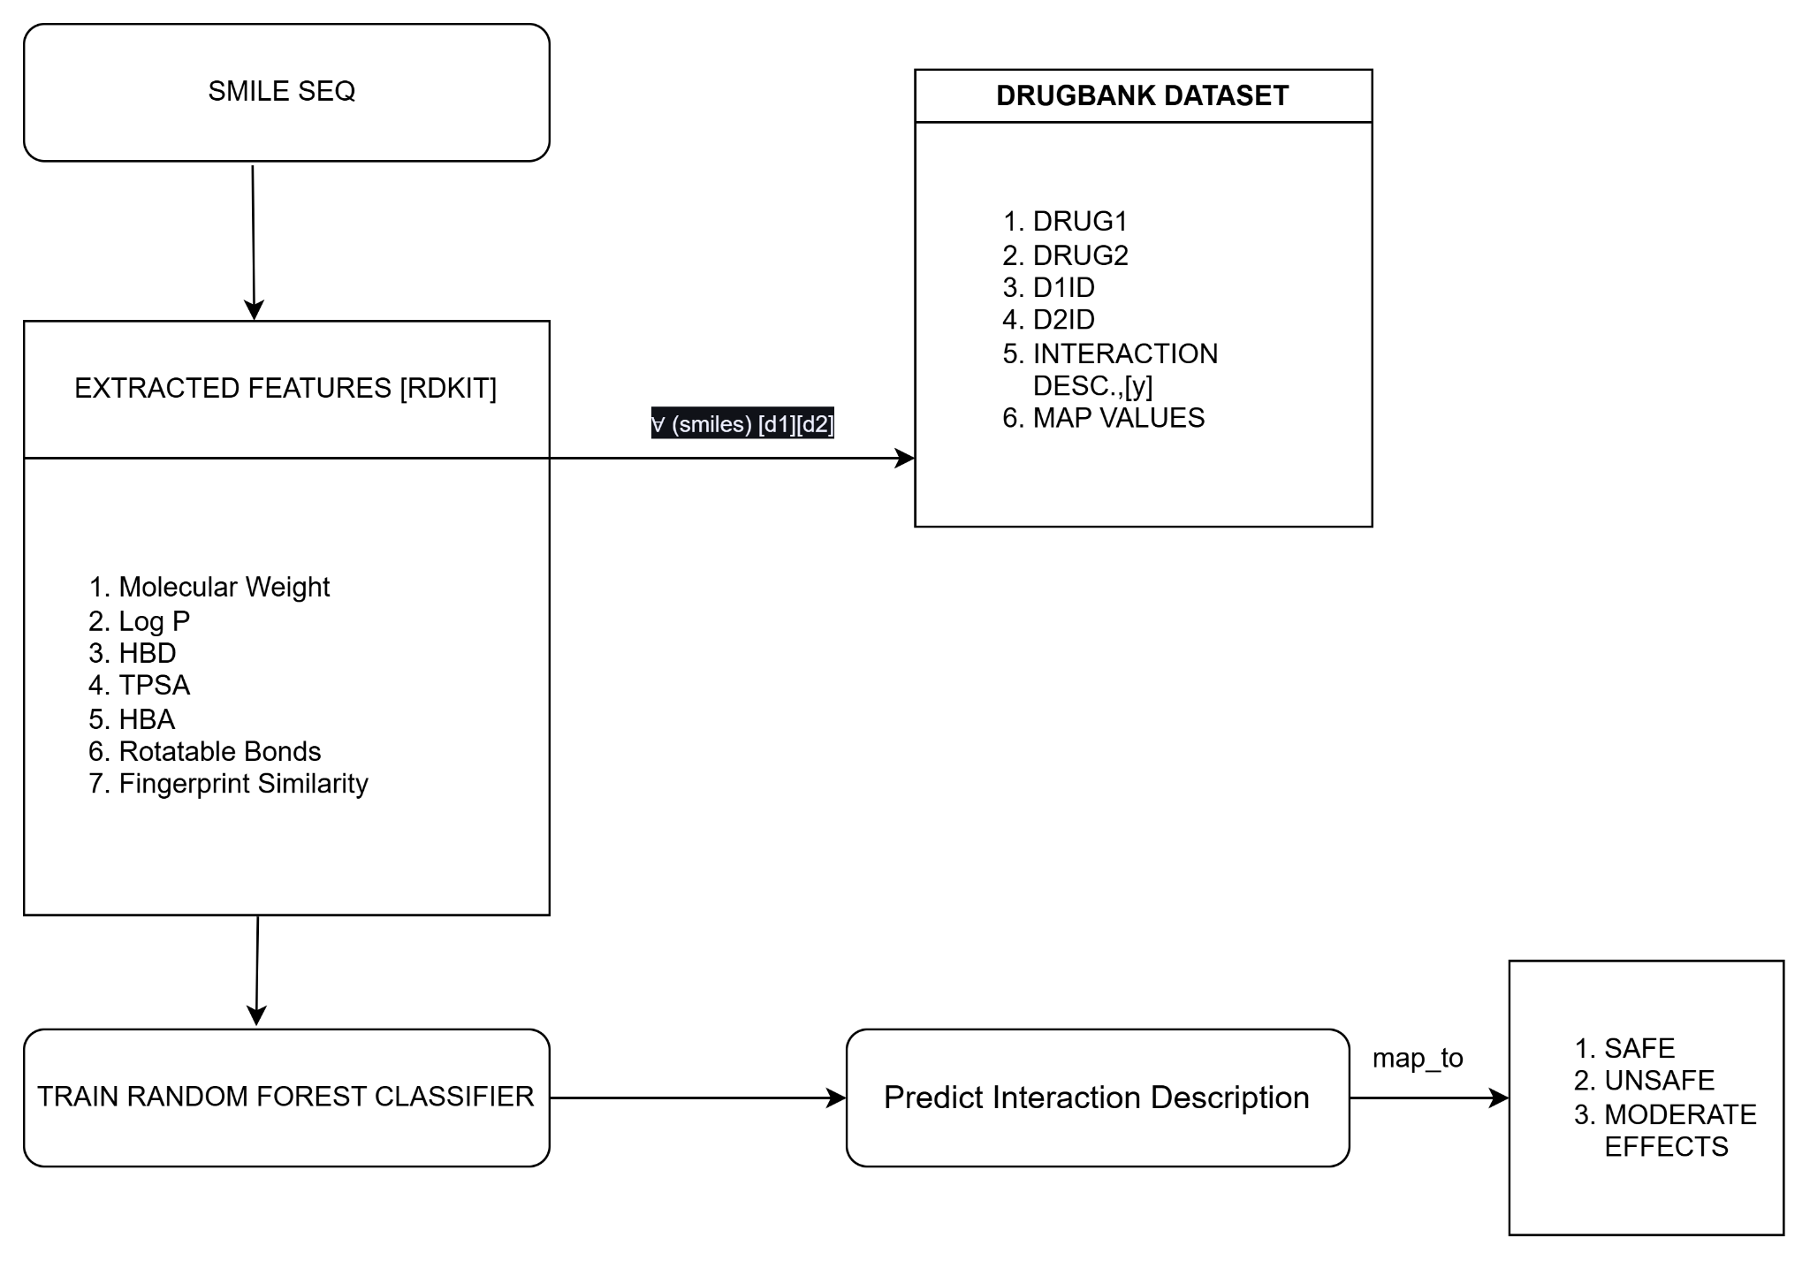
5. DETAILED DESIGN OF DRUG-DRUG INTERACTION

Slide 40
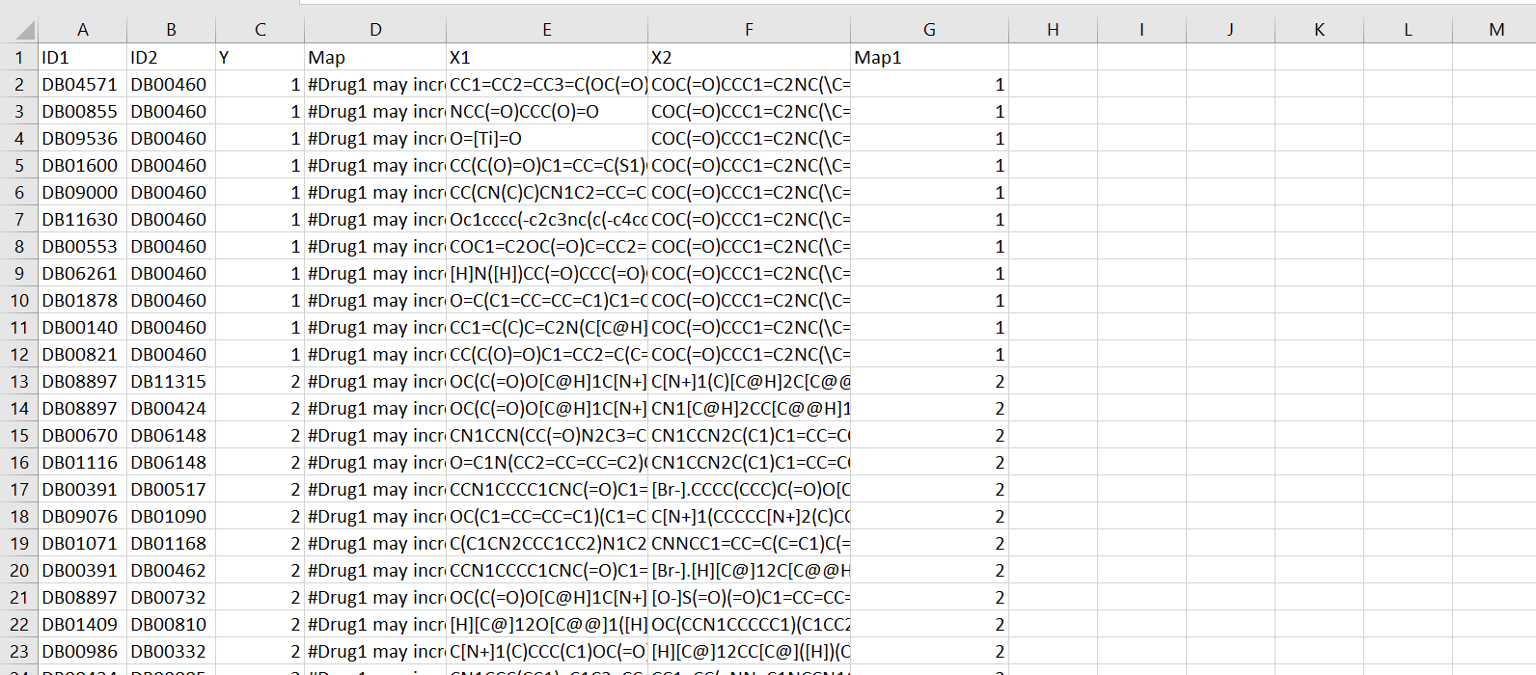
DETAILED DESIGN OF DRUG-DRUG INTERACTION
Total number of drug pairs :191809
DrugBank is a vital resource for your pharmaceutical research, offering comprehensive & reliable drug data
The Original DATASET1:

Slide 41
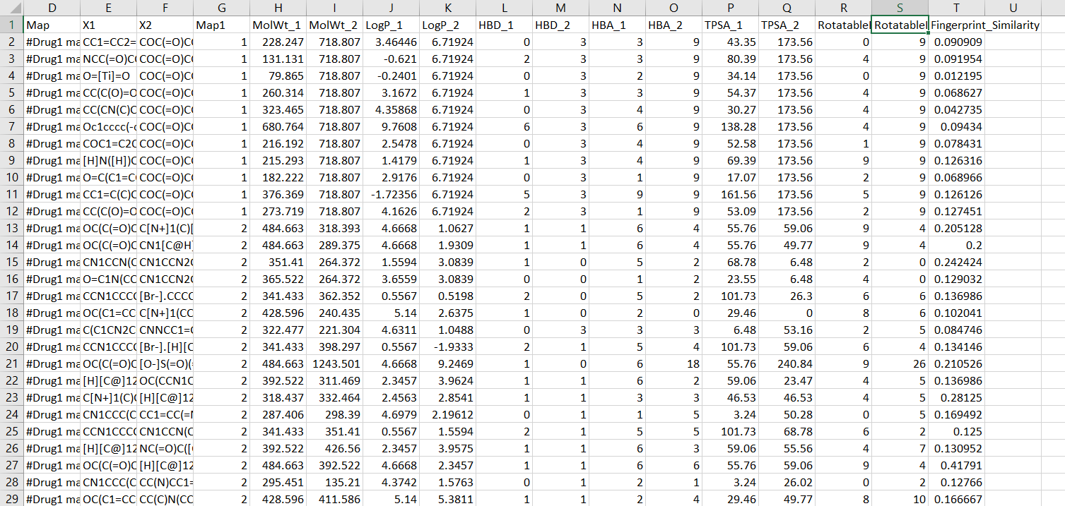
DETAILED DESIGN OF DRUG-DRUG INTERACTION
TRANSFORMED DATASET 2 :(with extracted features)

Slide 42
Algorithm for DDI
{Func. extract_features(smiles): #Extracting Physicochemical Features
Convert the SMILES string to a molecule using RDKit's Chem.MolFromSmiles()
If molecule is valid:
Compute descriptors using RDKit's Descriptors:
descriptor = [MolWt, MolLogP, TPSA, NumHDonors, NumHAcceptors,
NumRotatableBonds, HeavyAtomCount, NumAromaticRings,
NumHeteroAtoms, FractionCSP3]
return descriptor
Else:
return None
Func. compute_similarity(smiles1, smiles2): #Tanimoto Similarity
Convert both SMILES to fingerprints using RDKit
Compute and return Tanimoto similarity between the fingerprints}
1. Load DrugBank dataset containing Drug1, Drug2, and interaction labels
2. For each drug, extract chemical features using `extract_features(smiles)`
3. Calculate Tanimoto similarity between each drug pair using `compute_similarity(smiles1, smiles2)`
4. Concatenate features of Drug1, Drug2, and the similarity score to form the feature vector
5. Encode interaction labels as the target for classification
6. Split the dataset into training and testing sets (e.g., 80:20 ratio)
7. Normalize features using `StandardScaler` and store in `train_features_scaled` and `test_features_scaled`
8. Initialize `RandomForestClassifier()` as the classification model
9. Train the model on `train_features_scaled` and `train_y`
10. Evaluate model performance on `test_features_scaled` and `test_y`
11. Predict interactions for new drug pairs using their SMILES inputs
input: SMILES of Drug1 and Drug2
output: Predicted Drug-Drug Interaction Class
given: DrugBank dataset (Drug1, Drug2, IDs, Interaction Description)

Slide 43
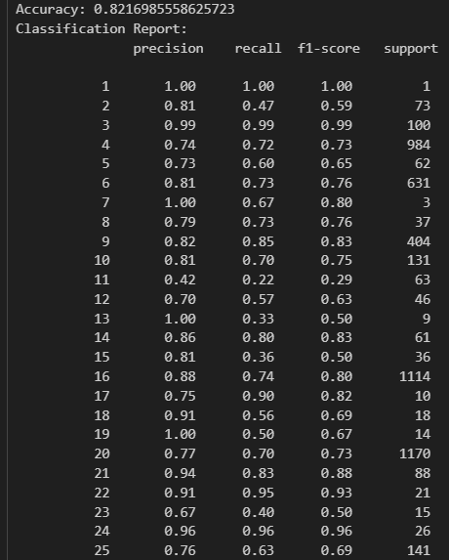
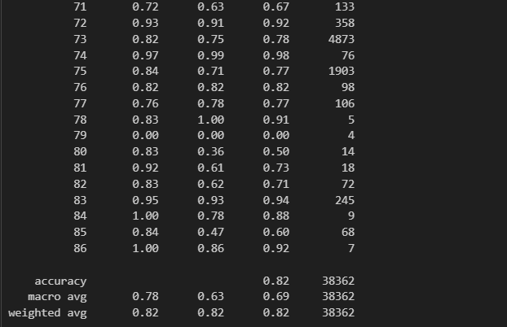
EVALUATION OF DRUG-DRUG INTERACTION RANDOM CLASSIFIER
ACCURACY :82.16%

Slide 44
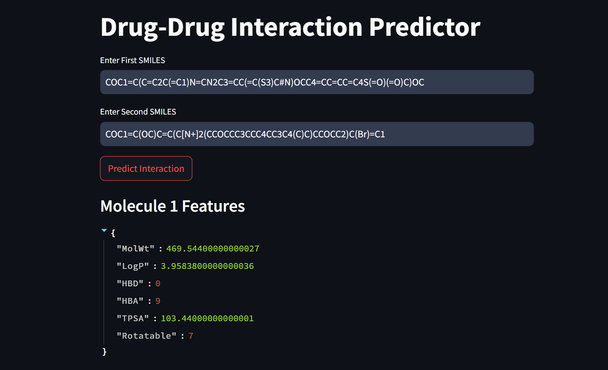
Sample test case of DRUG-DRUG INTERACTION

Slide 45
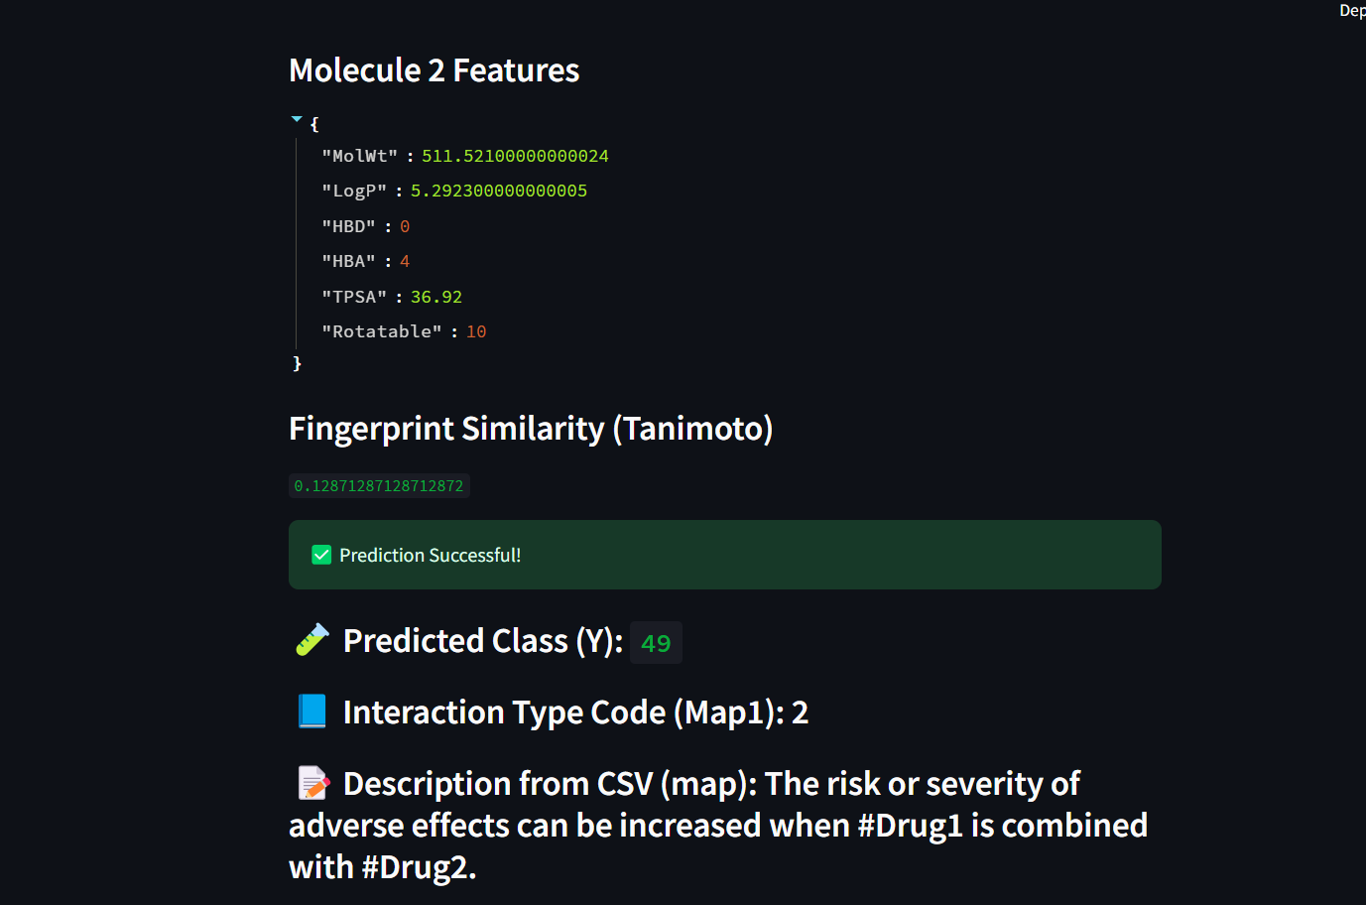

Slide 46
CONCLUSION
Holistic, Patient‑Centric Ranking Combining quantum‑enhanced affinity predictions with docking analysis, ADMET profiling, side‑effect scoring, and DDI prediction delivers a truly multidimensional evaluation of cancer–comorbidity drug pairs.
Quantum‑Classical Advantage The hybrid model uncovers subtle molecular interactions that improve binding affinity estimates beyond classical methods, strengthening overall ranking fidelity.
Clinical Translation Focus Restricting to FDA‑approved drugs and encapsulating the workflow in a Streamlit app accelerates in vitro validation and real‑world adoption.
In conclusion, a comprehensive multi-criteria decision-making (MCDM) approach is employed to systematically rank cancer-disease drug pairs for comorbid patients. By incorporating diverse factors such as ADMET properties, side effects, auto-docking results, quantum-enhanced binding affinity predictions, and drug-drug interactions, the analysis offers a robust evaluation of each drug's potential. This methodology ensures that each drug's therapeutic profile is considered holistically, enabling the identification of the most promising candidates for treatment. Ultimately, the approach provides a well rounded ranking that helps optimize drug selection, improving the likelihood of efficacy and minimizing adverse effects for patients with complex medical conditions.

Slide 47
REFERENCES
[1] Koras, K., Juraeva, D., Kreis, J., Mazur, J., Staub, E., Szczurek, E. (2020). Feature selection strategies for drug sensitivity prediction. Scientific Reports, 10(1), 9377.
[2] Deng, J., Wang, F. (2020). An Informatics-based Approach to Identify Key Pharmacological Components in Drug-Drug Interactions. AMIA Jt Summits Transl Sci Proc. 2020 May 30;2020:142-151.
[3] Tian, H., Zhang, L., Wang, Y. (2022). ADMETboost: A Web Server for Accurate ADMET Prediction. Bioinformatics 38(6), 1784-1790.
[4] Peng X, Gibbs E, Silverman JM, Cashman NR, Plotkin SS. A method for systematically ranking therapeutic drug candidates using multiple uncertain screening criteria. Stat Methods Med Res. 2021.
[5] Alnaqbi, A., Howarth, M., Al Mazrouei, N., Alkaabi, R. (2024). Development of the Emirates Multi-Criteria Decision Analysis Tool for Orphan Drugs. J Pharm Policy Pract 17, 42.
[6] Schreier, J., M¨ uller, S., Huber, P. (2024). Integration of FAERS, DrugBank, and SIDER Data for Machine Learning-Based Detection of Adverse Drug Reactions. J Biomed Inform 152, 103456.
[7] Yousif, M., Ahmed, K., Zhao, L. (2024). A New Quantum Circuit of Quantum Convolutional Neural Network for X-Ray Image Classification. IEEE Trans Med Imaging 43(2), 321-334.
[8] Garani, G., Patel, R., Nguyen, T. (2024). Hybrid Quantum Neural Network Approaches to Protein–Ligand Binding Affinity Prediction. J Chem Theory Comput 20, 1256-1271

Slide 48
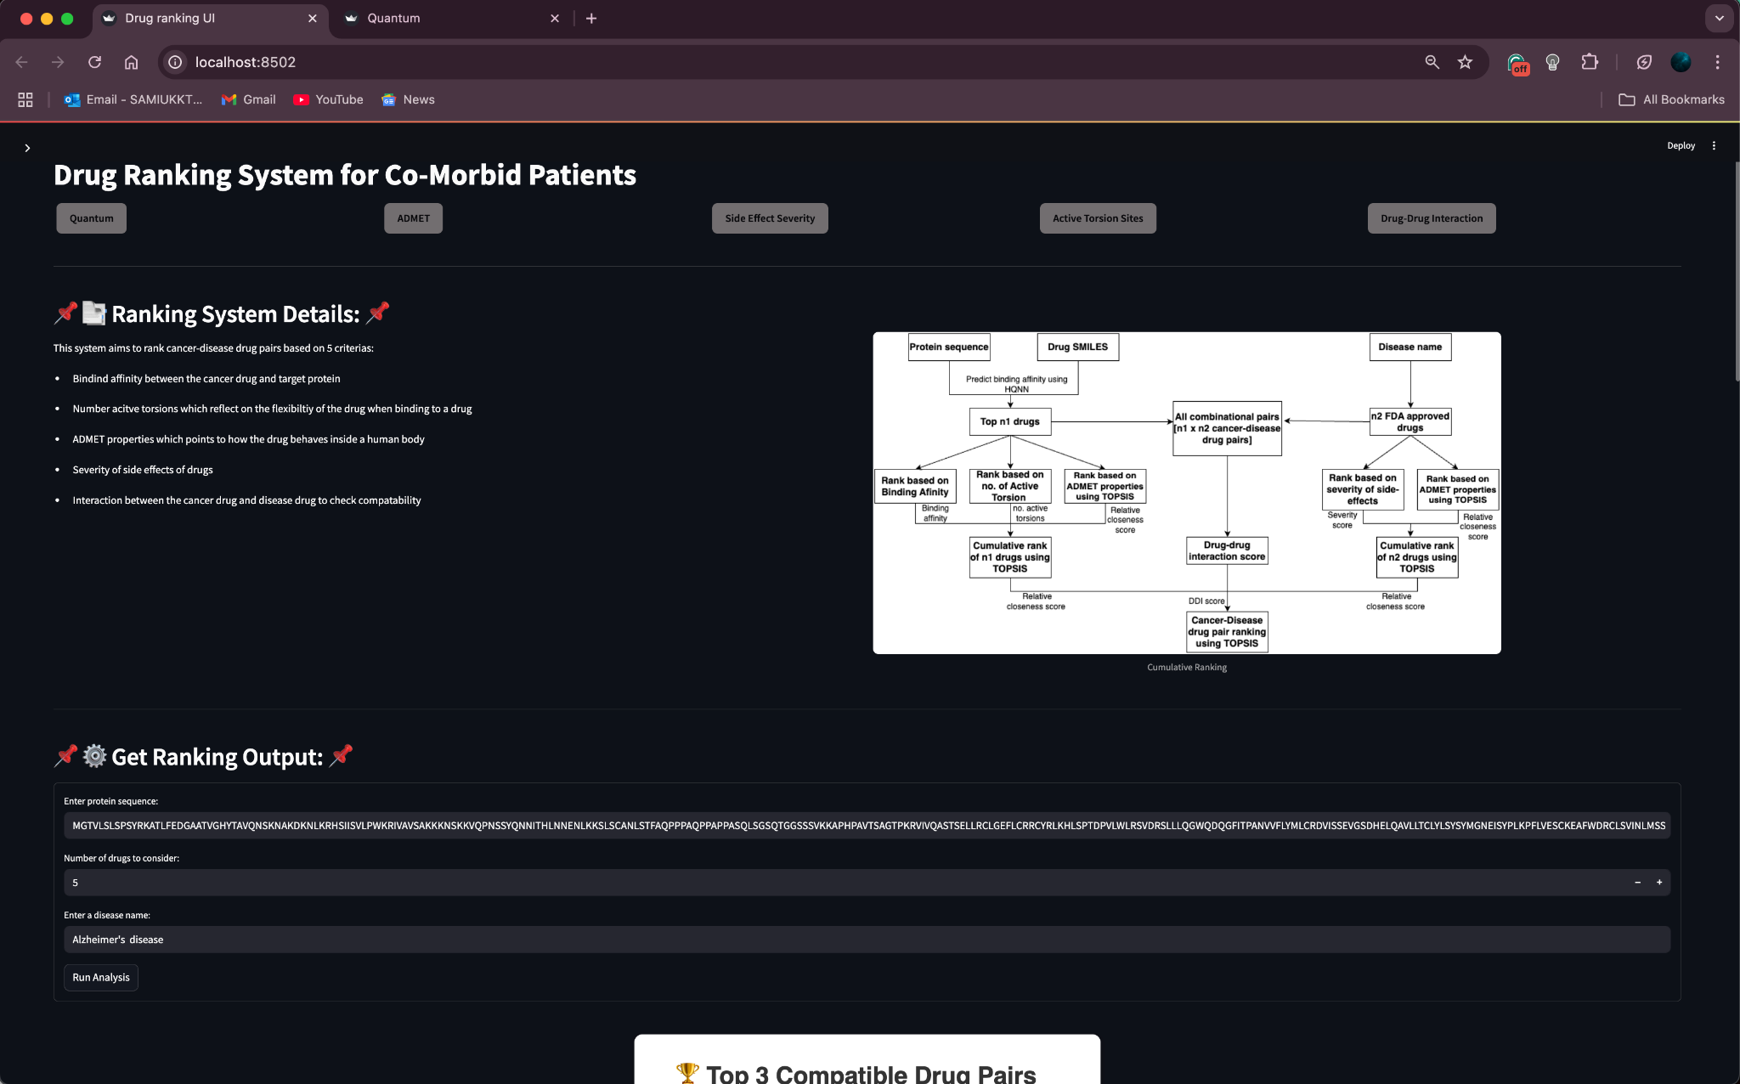
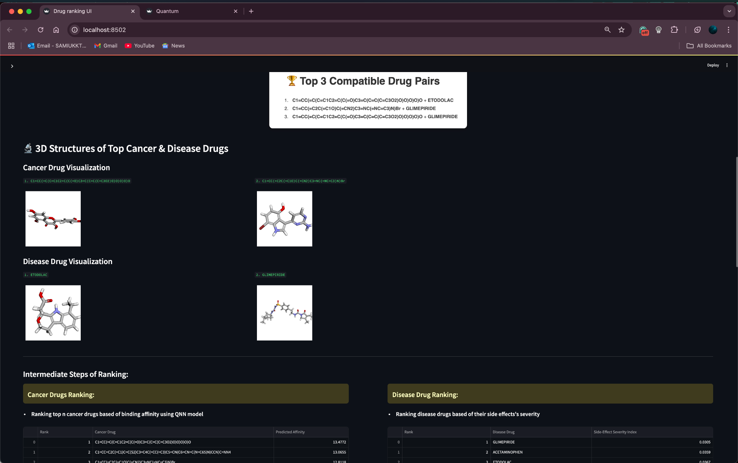
Ranking UI

Slide 49
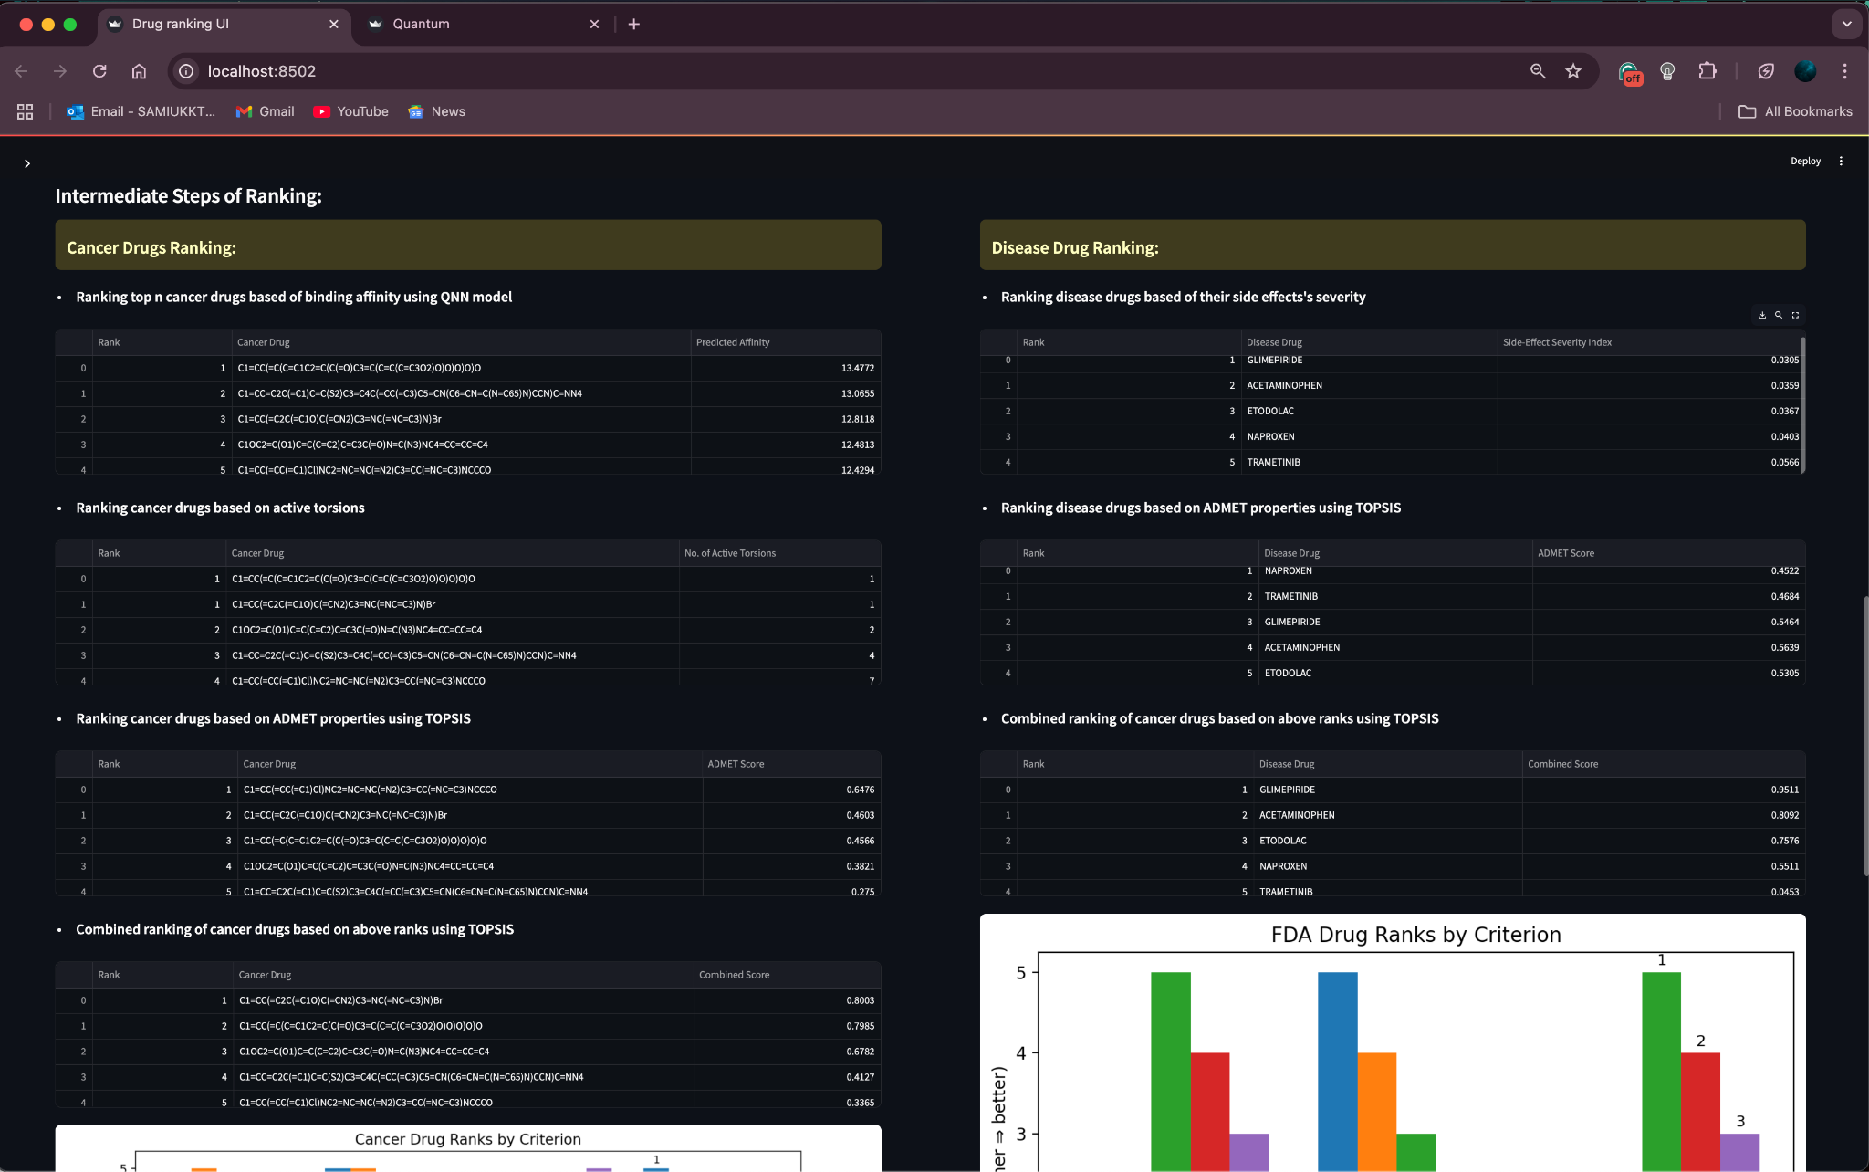
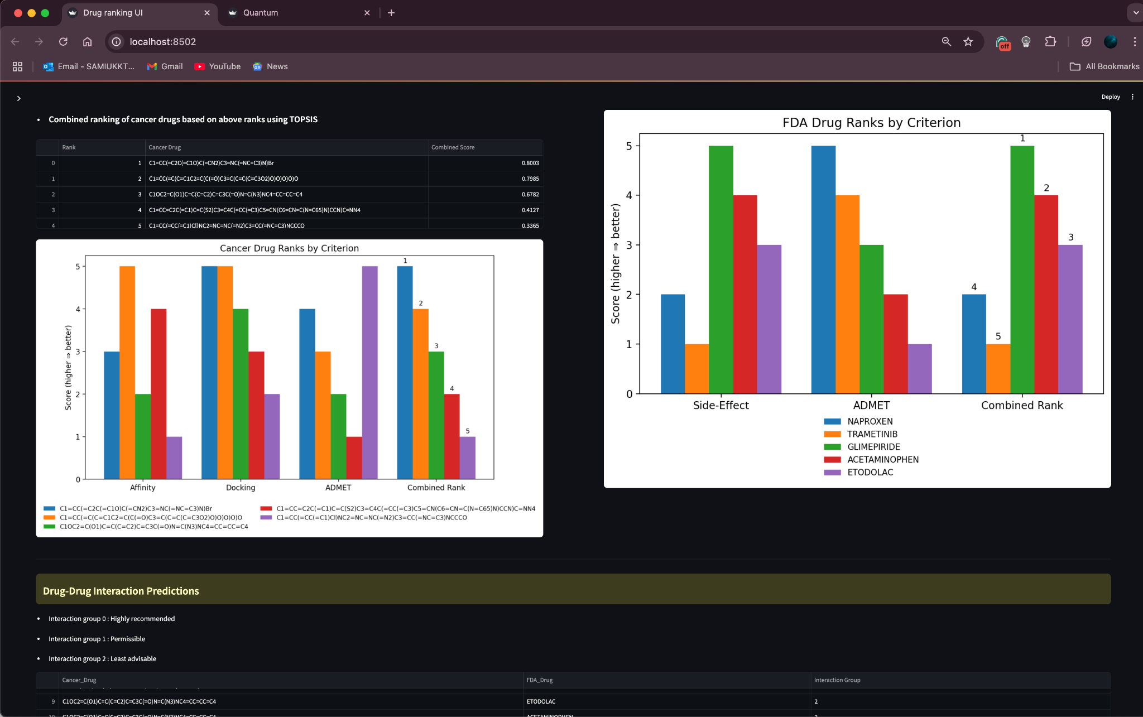
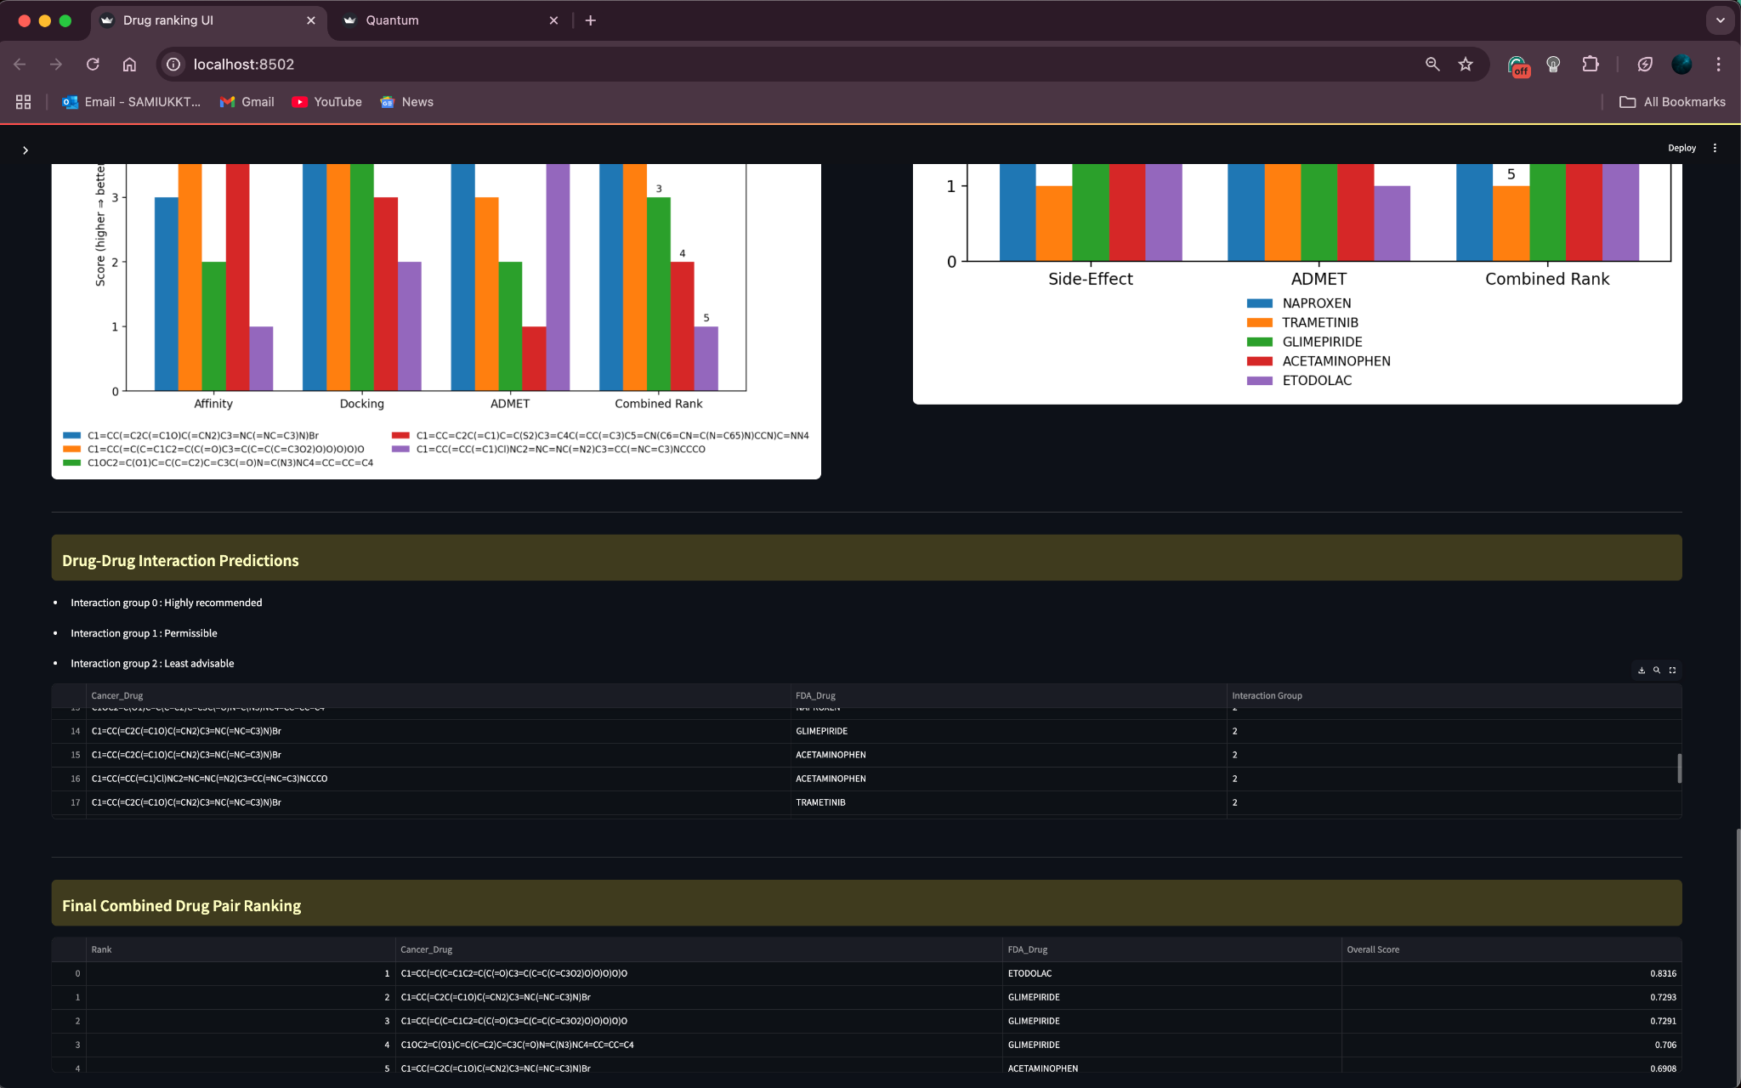

Slide 50
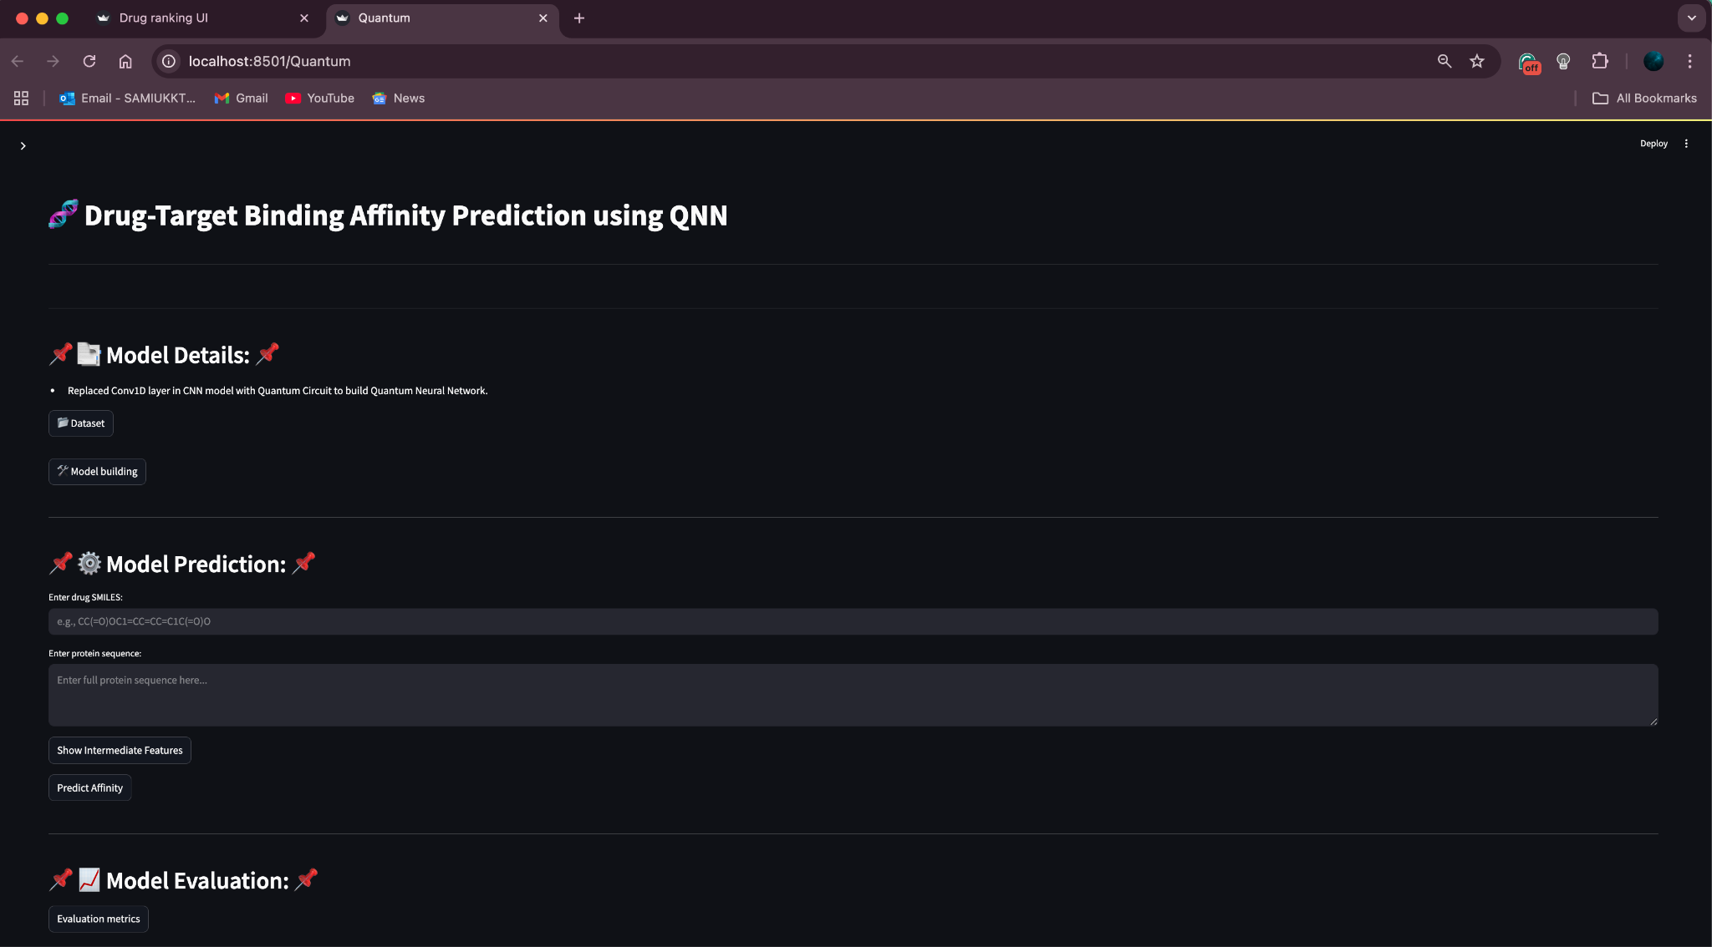
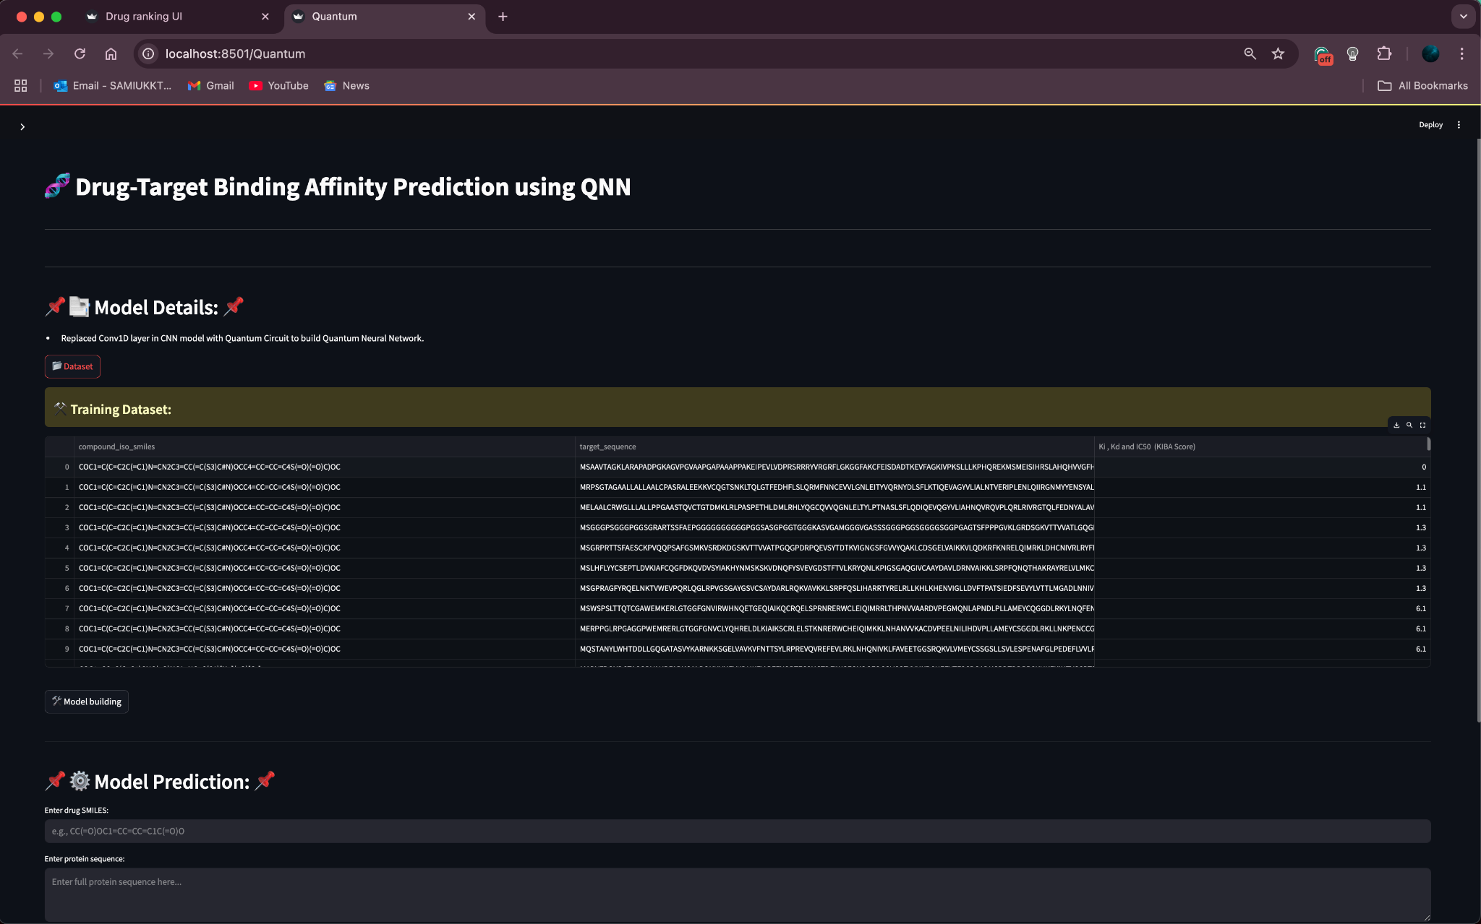
Quantum UI

Slide 51
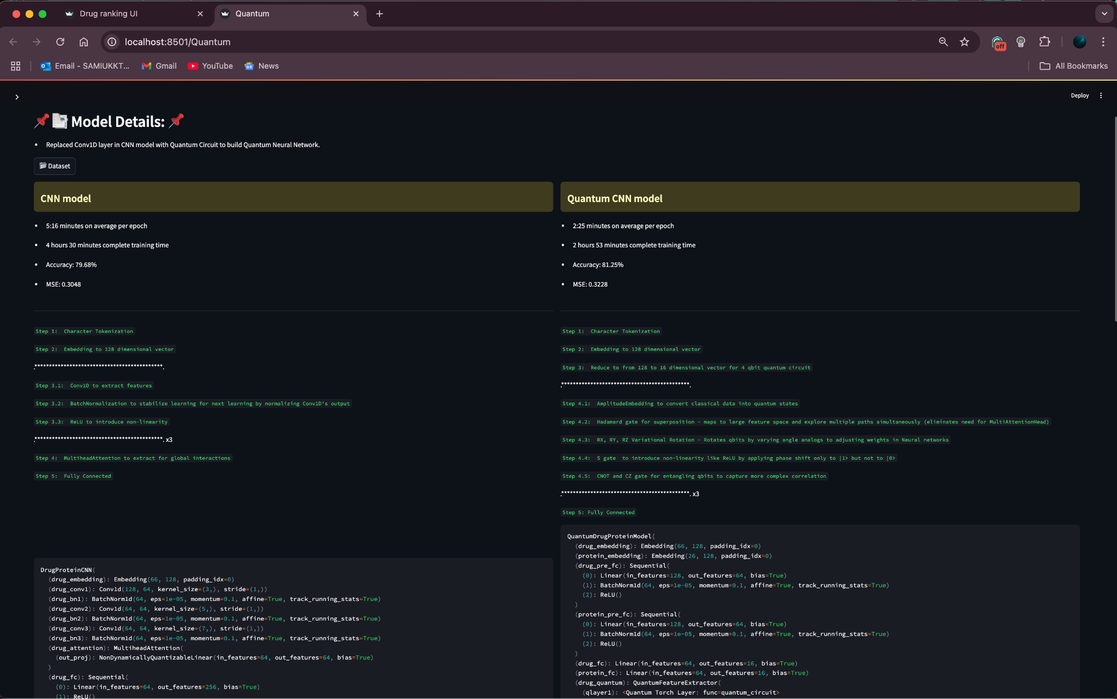
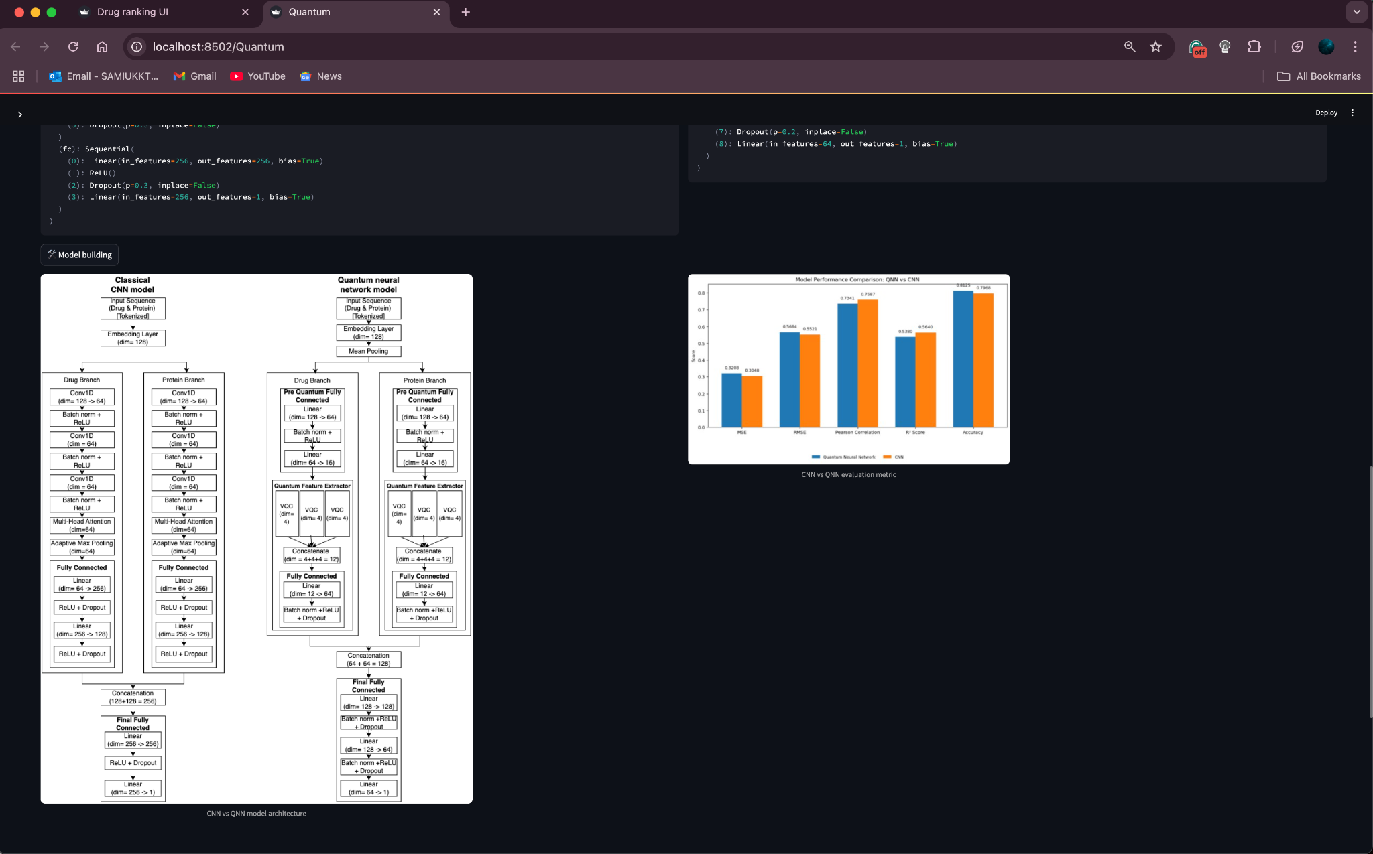
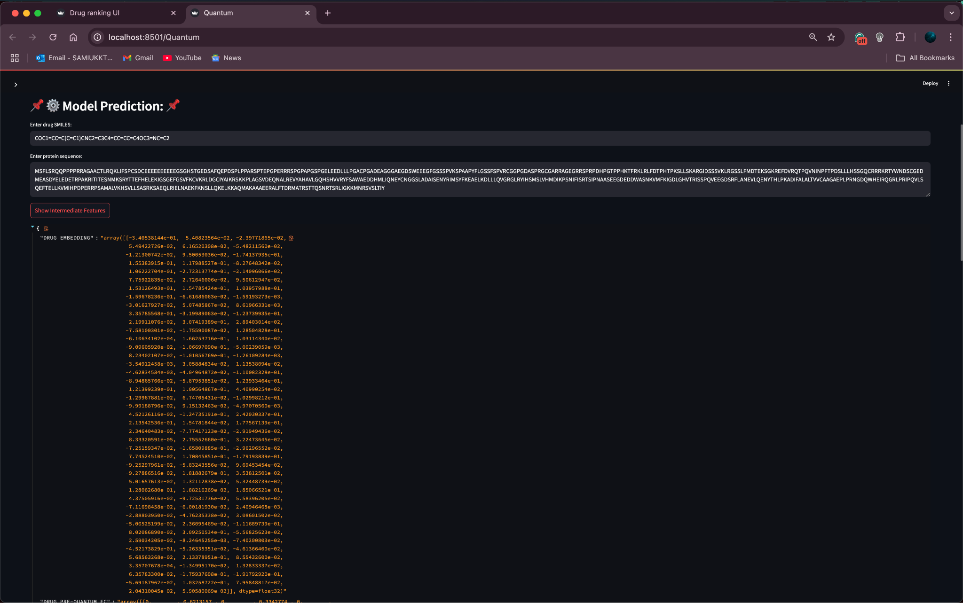
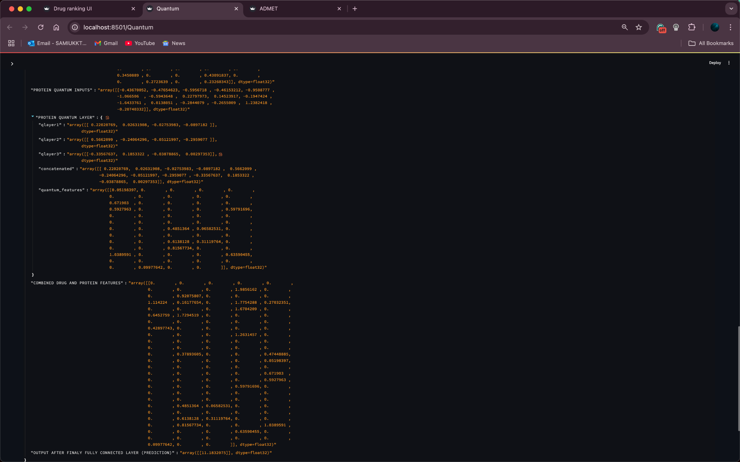

Slide 52
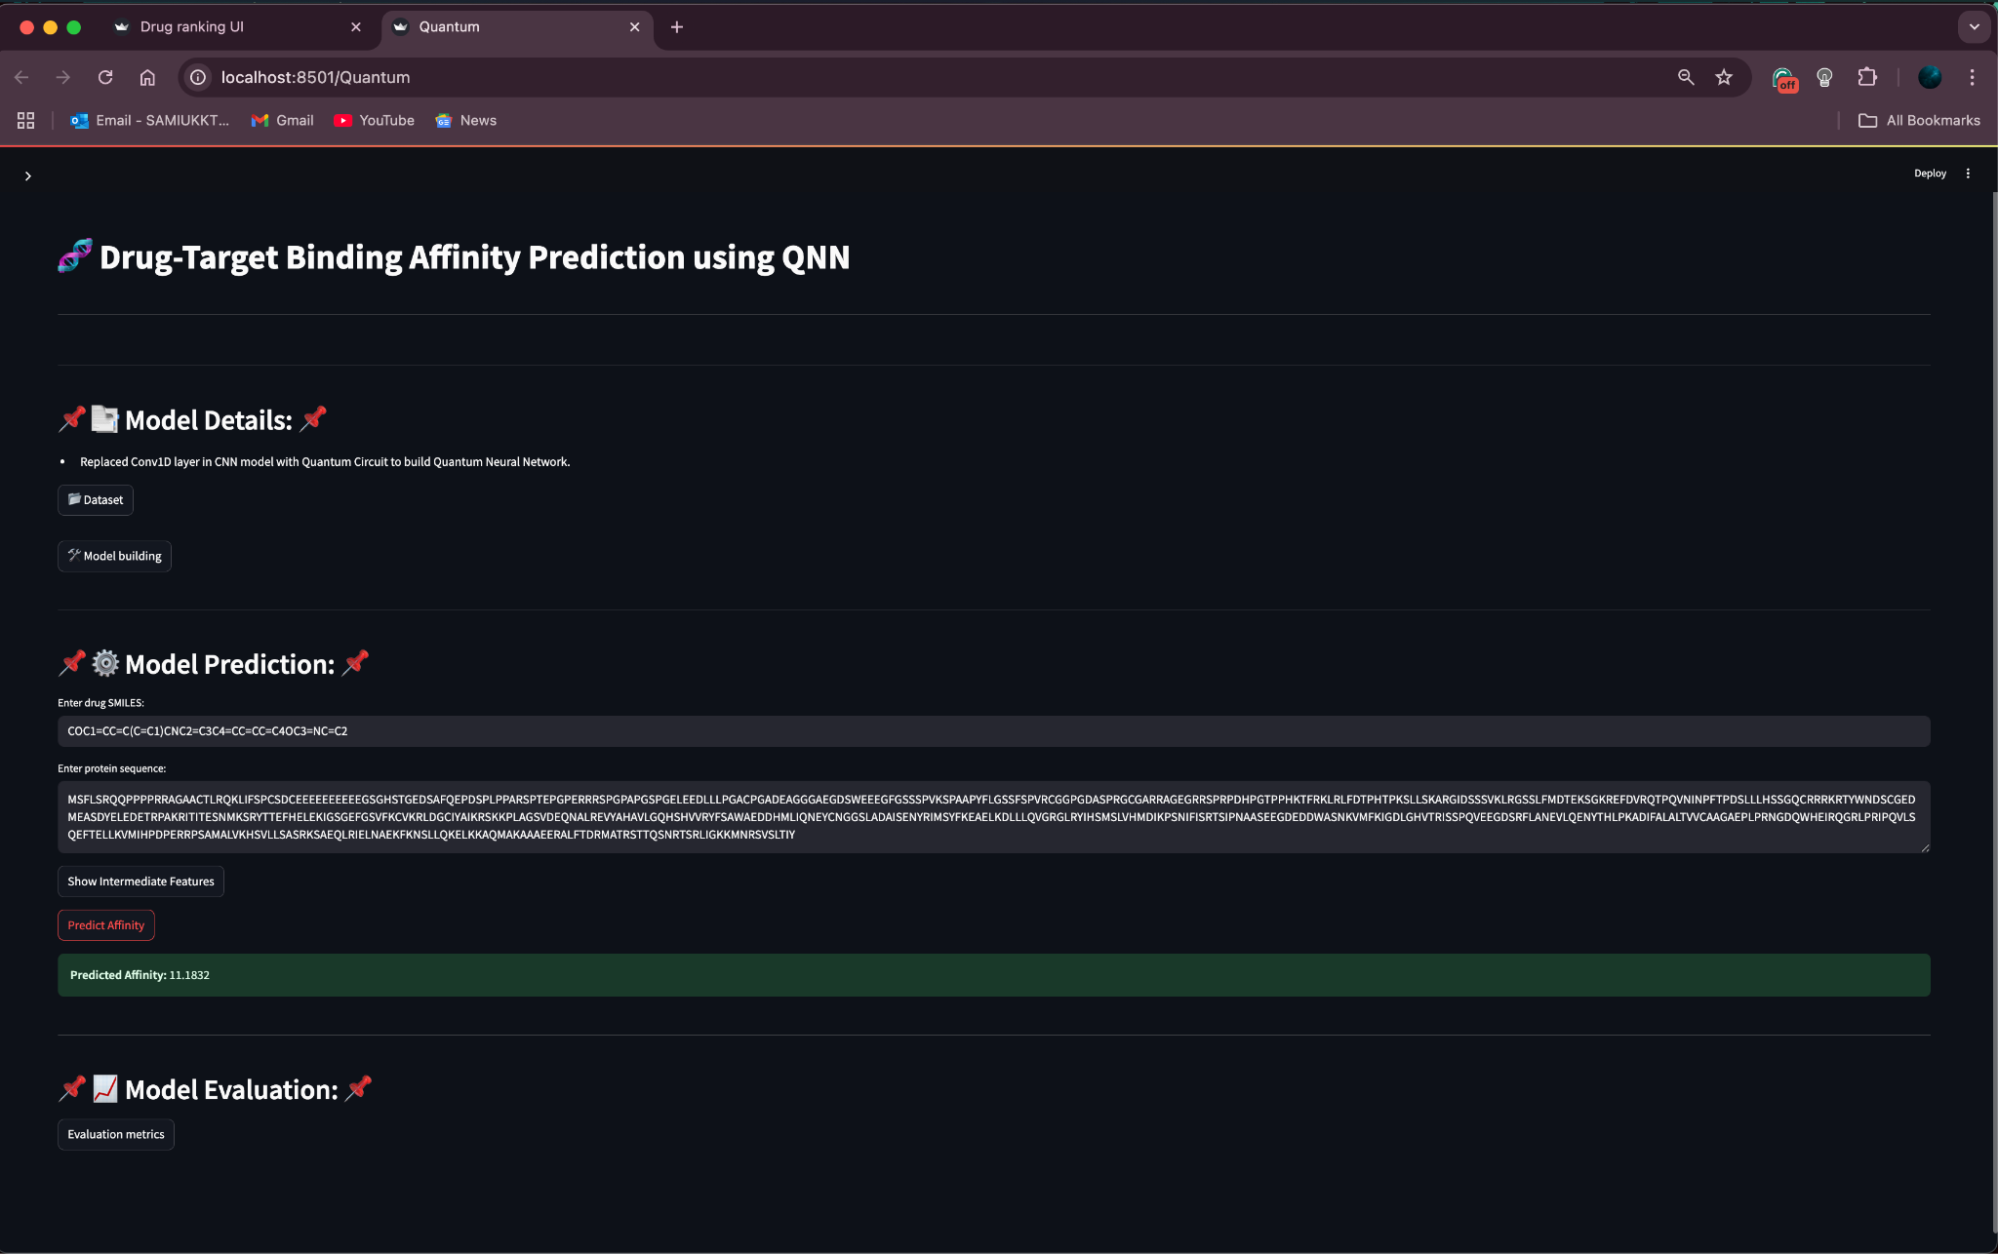
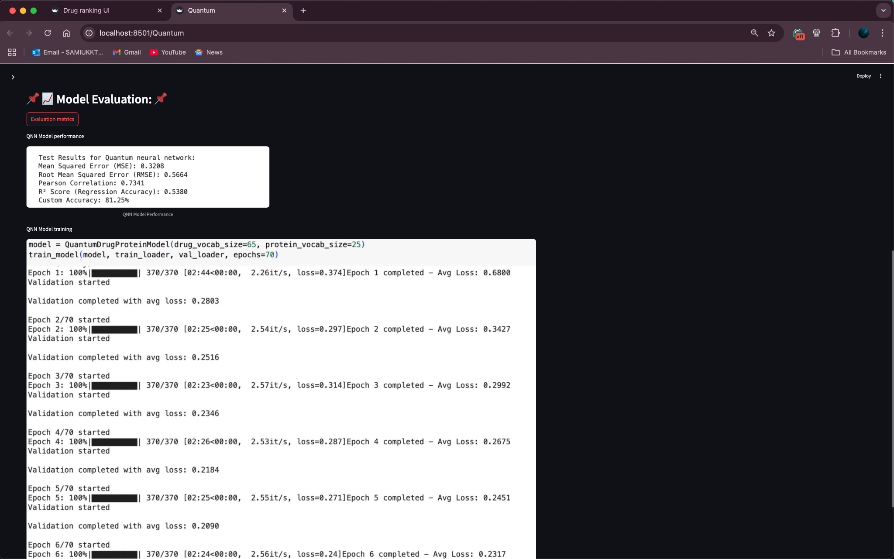

Slide 53
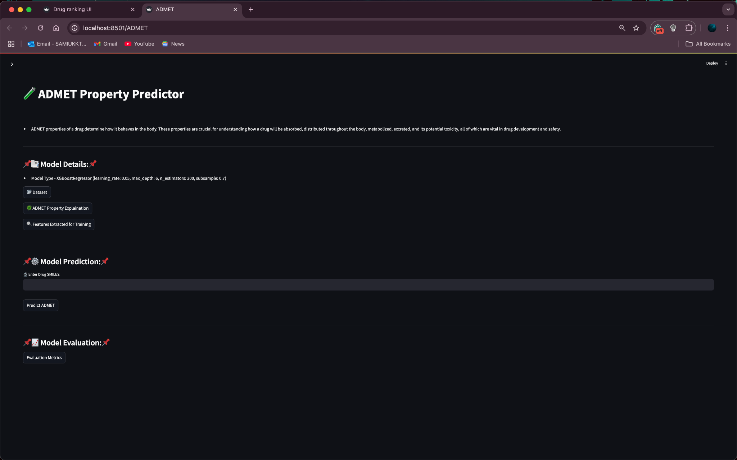
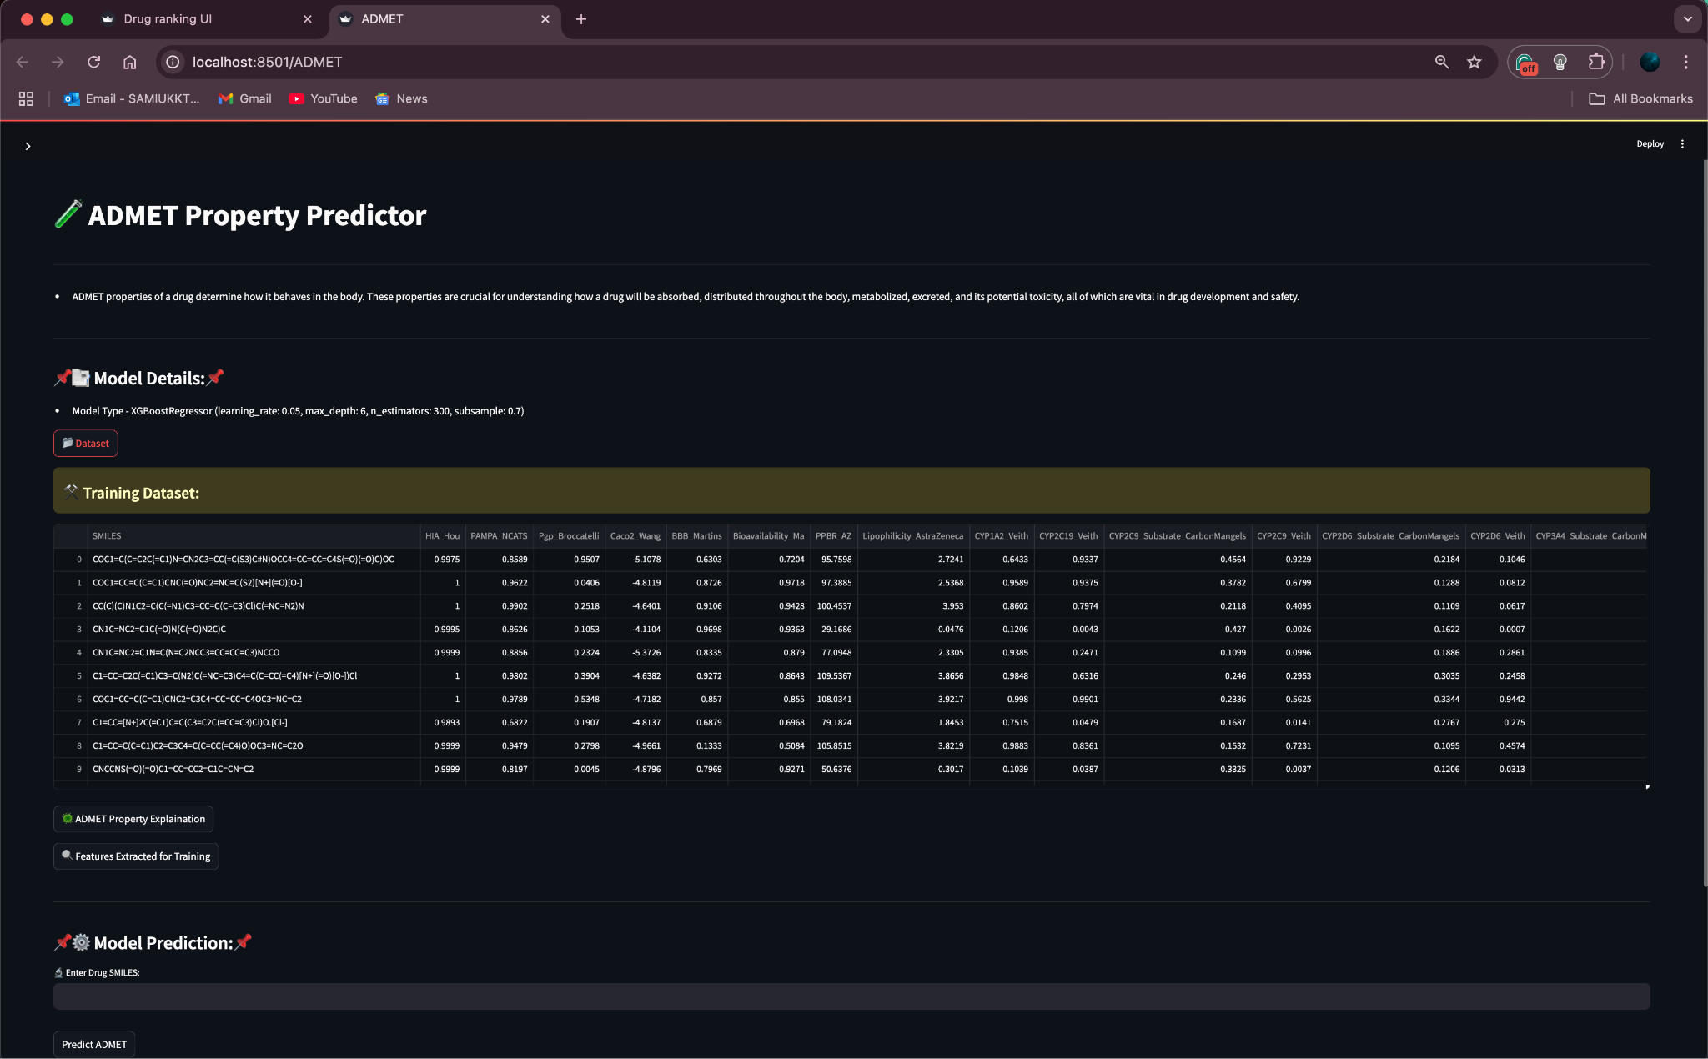
ADMET UI

Slide 54
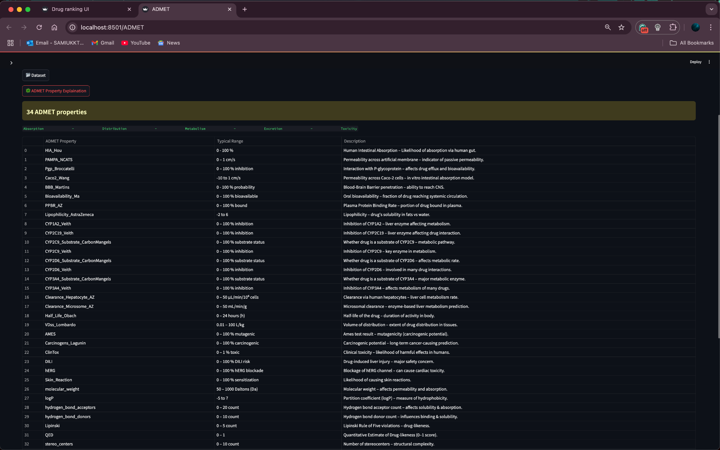
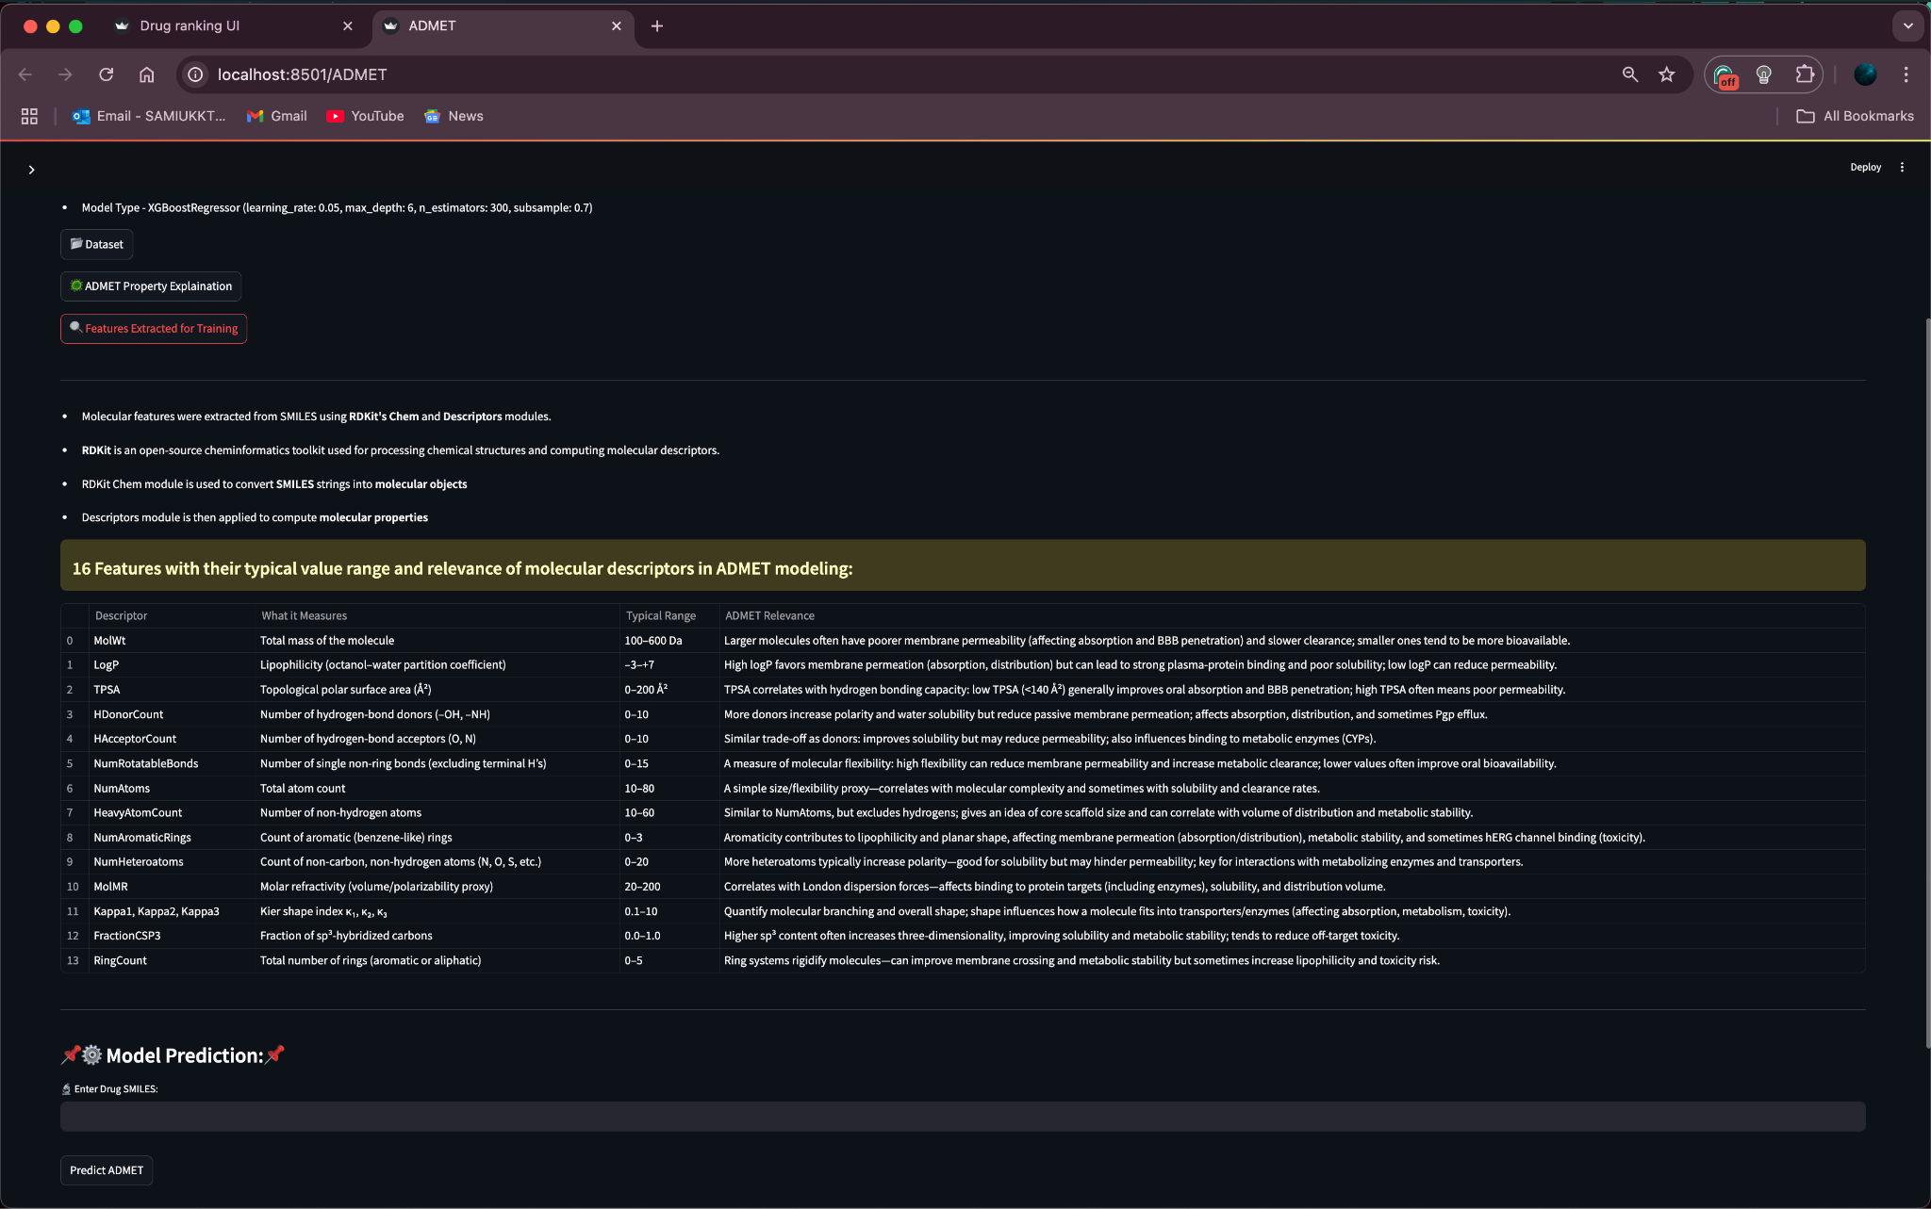
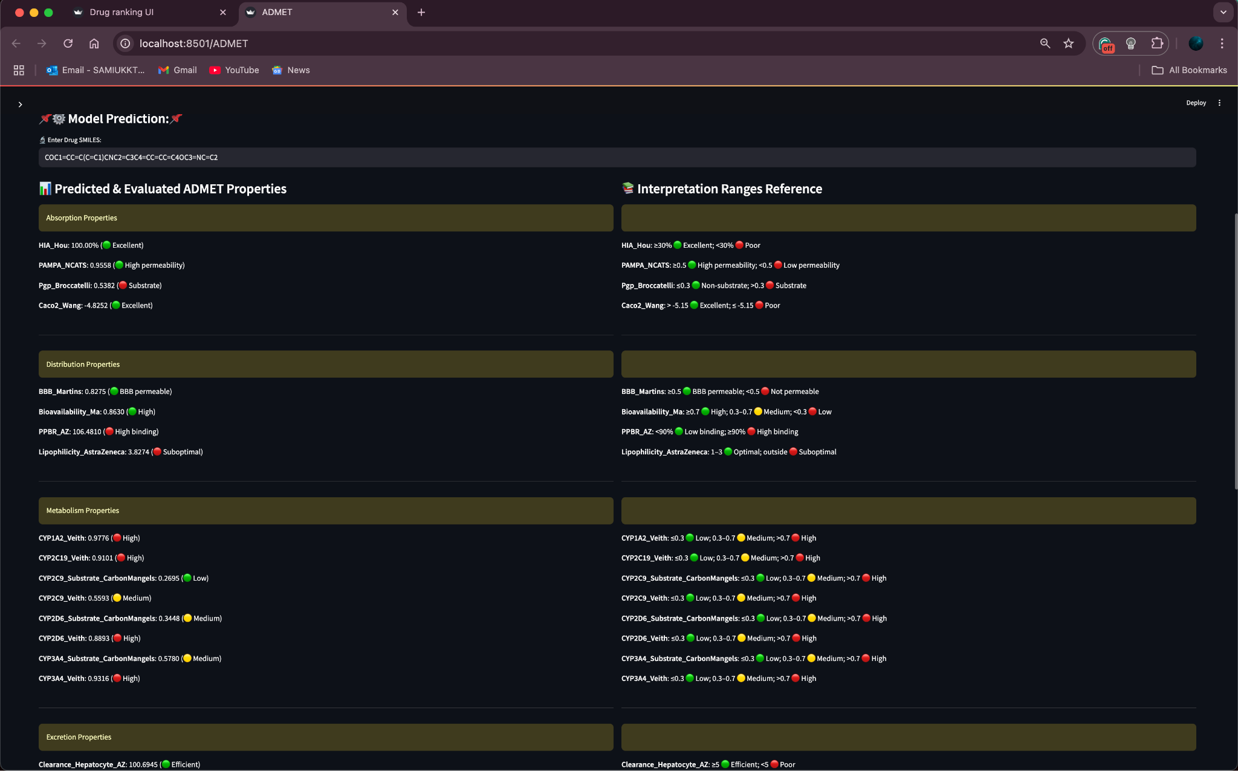
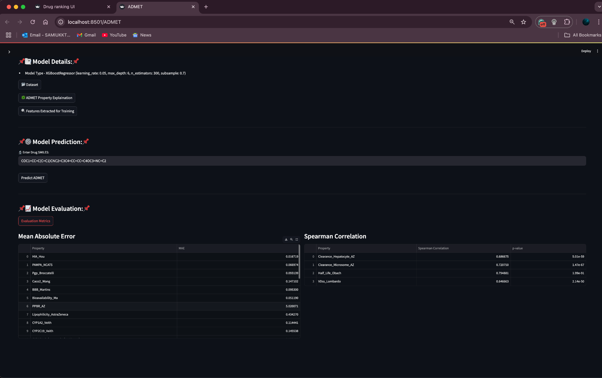

Slide 55
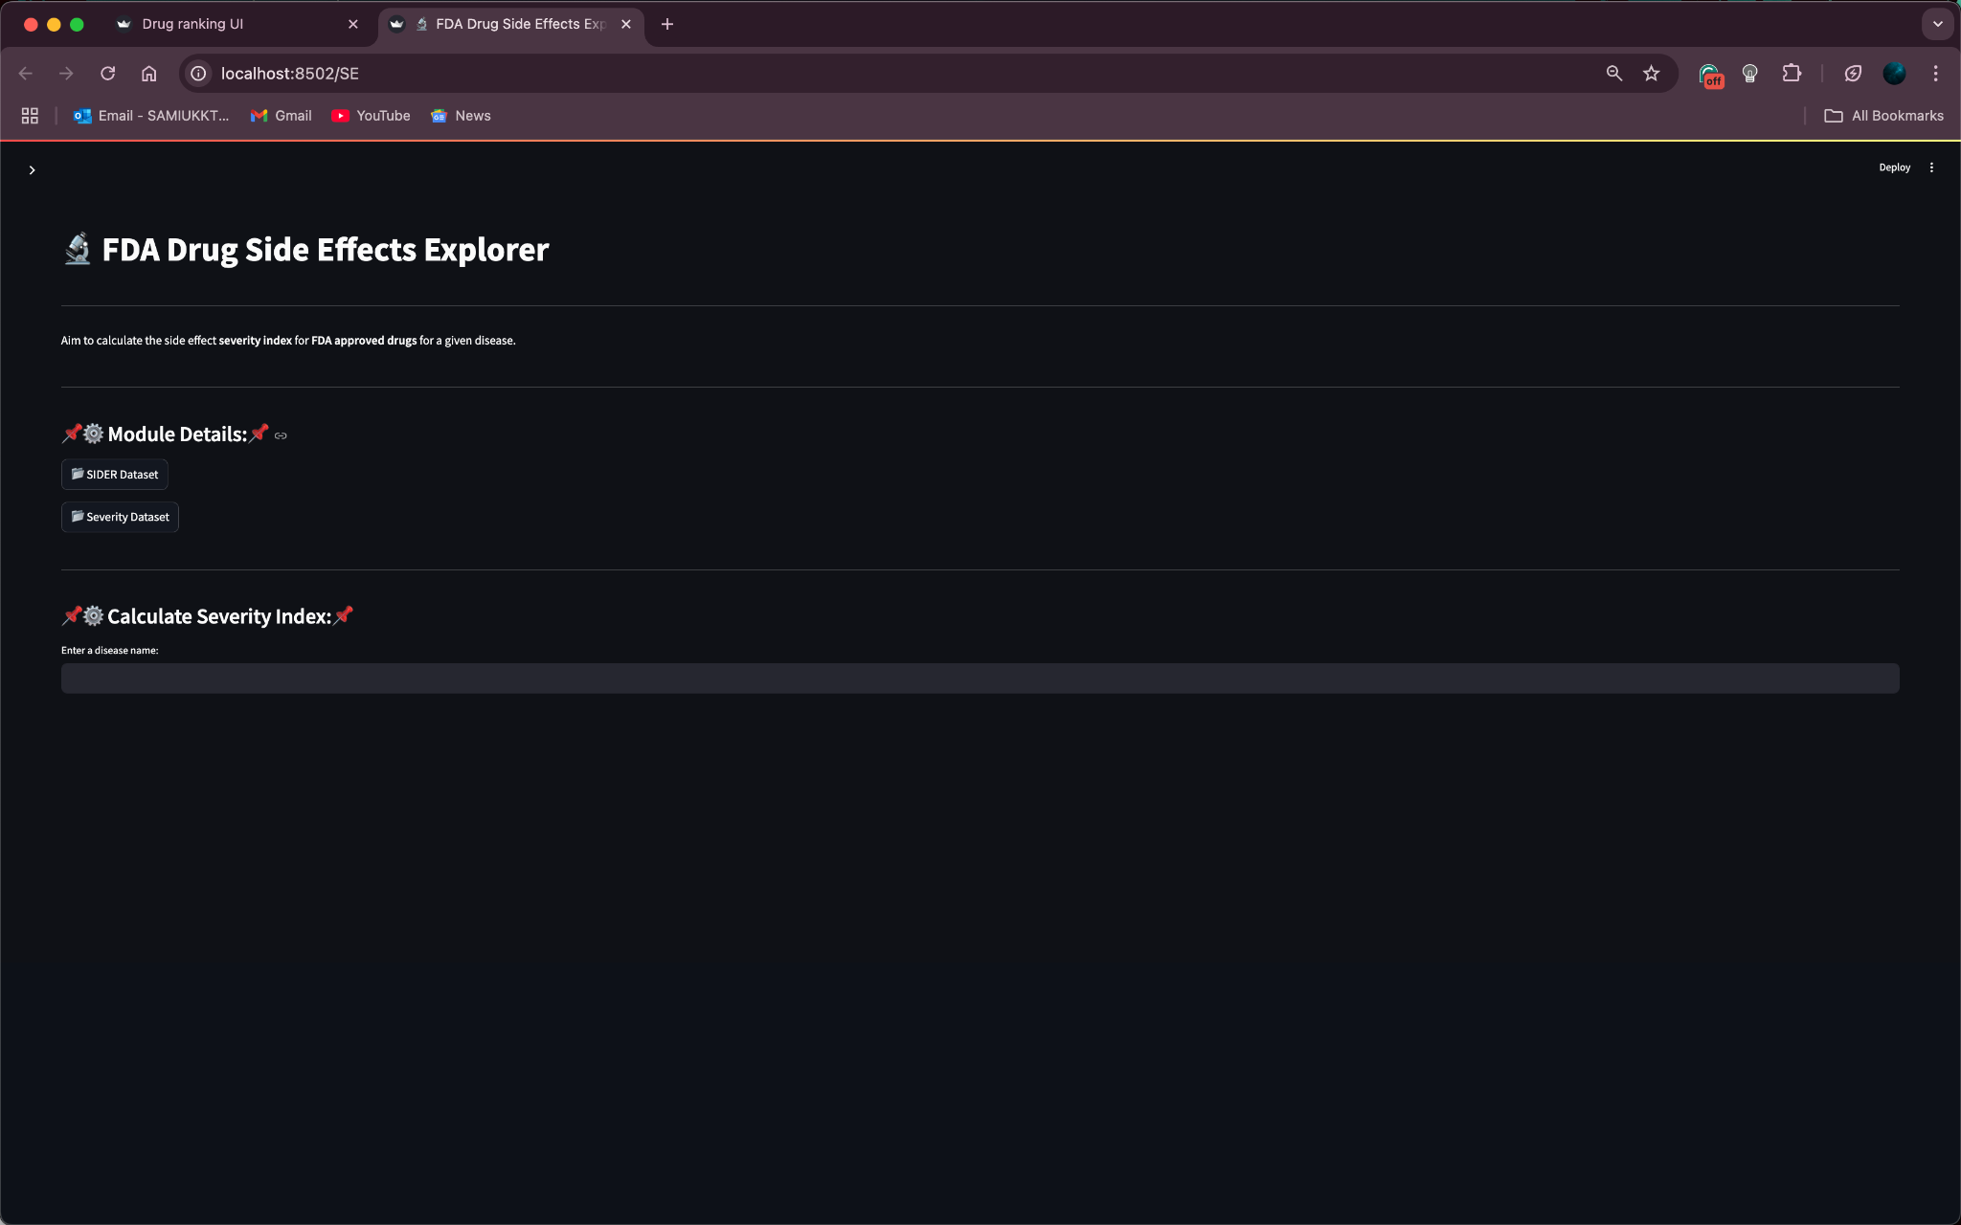
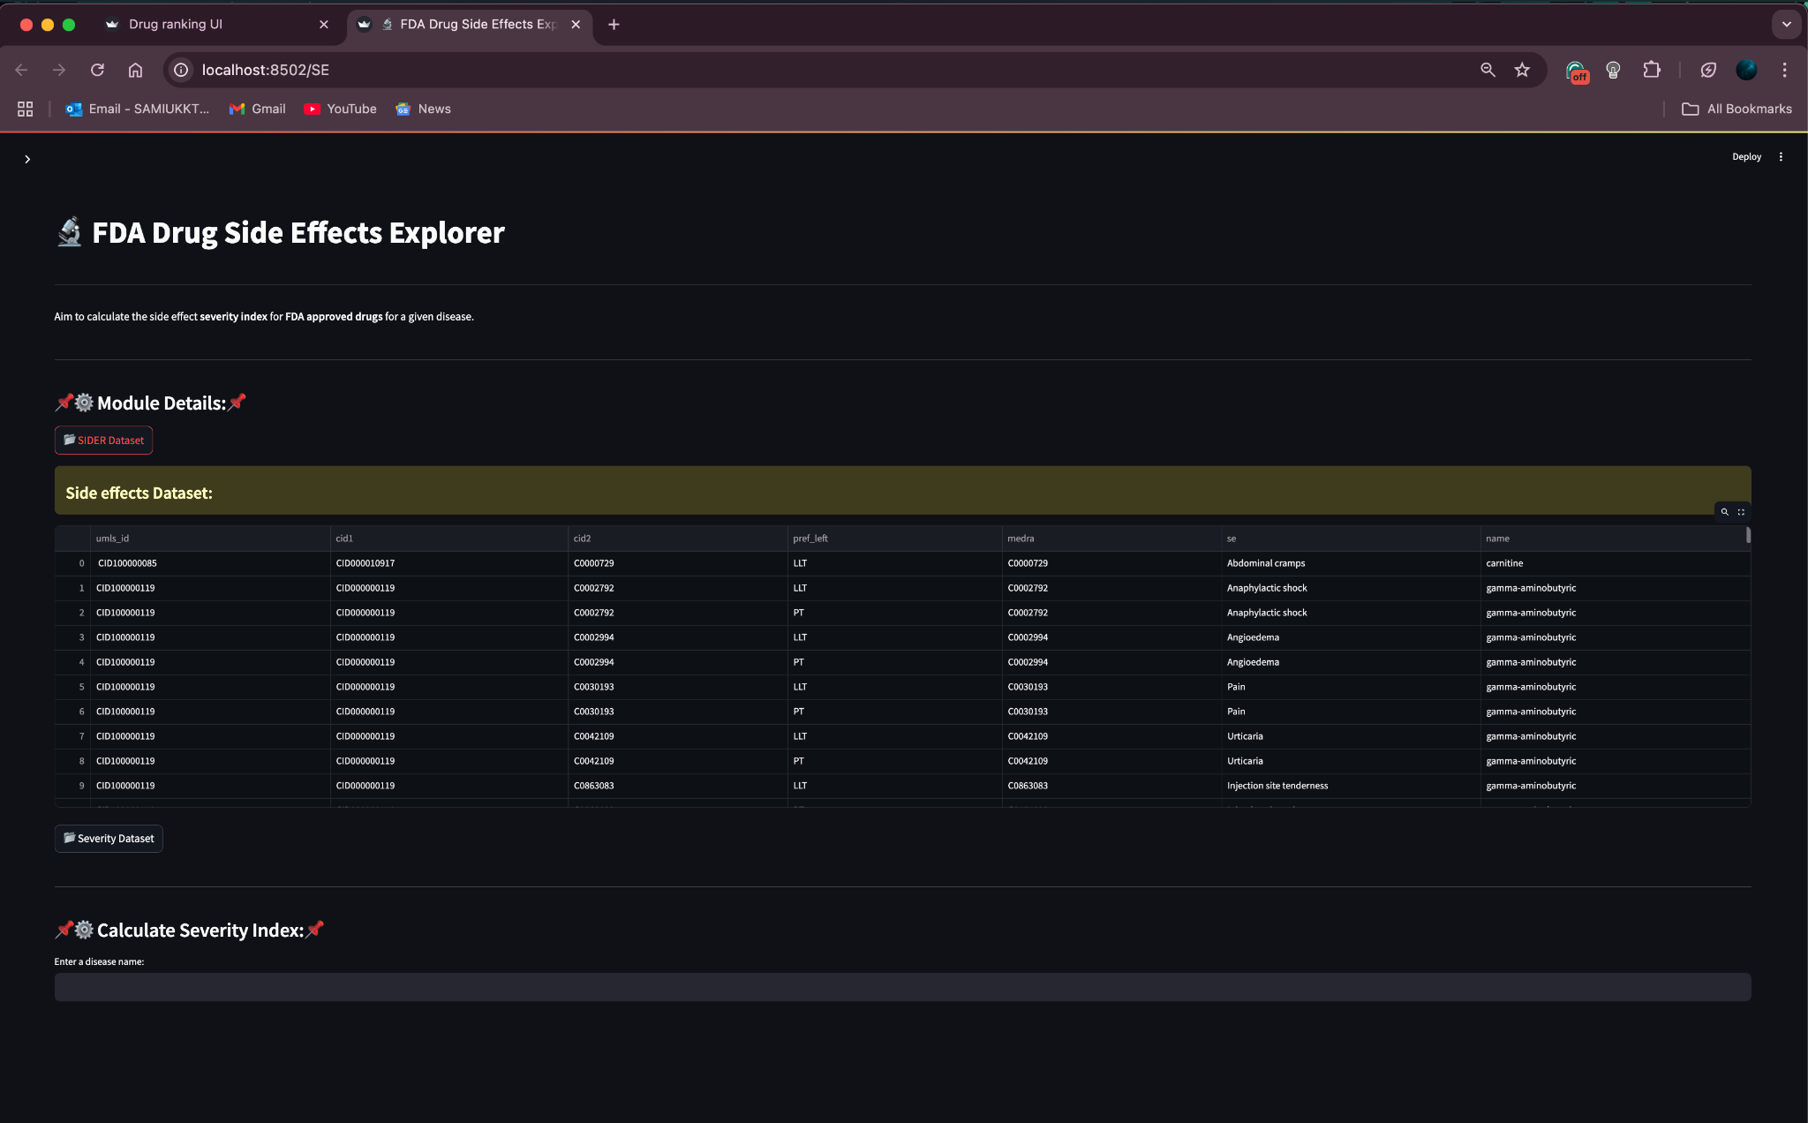
Side Effect Severity UI

Slide 56



Slide 57


Docking UI

Slide 58


Drug-Drug Interaction UI

Slide 59





